Slide 1
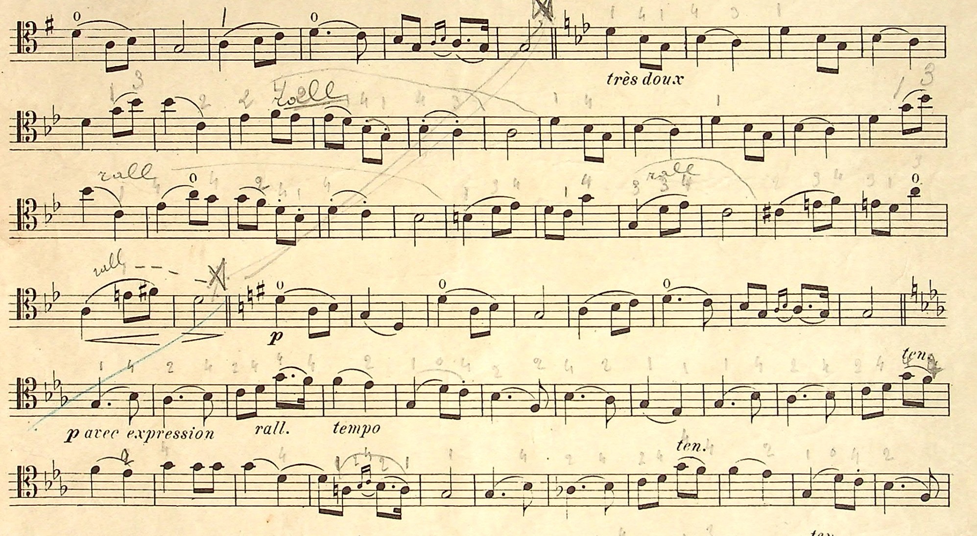


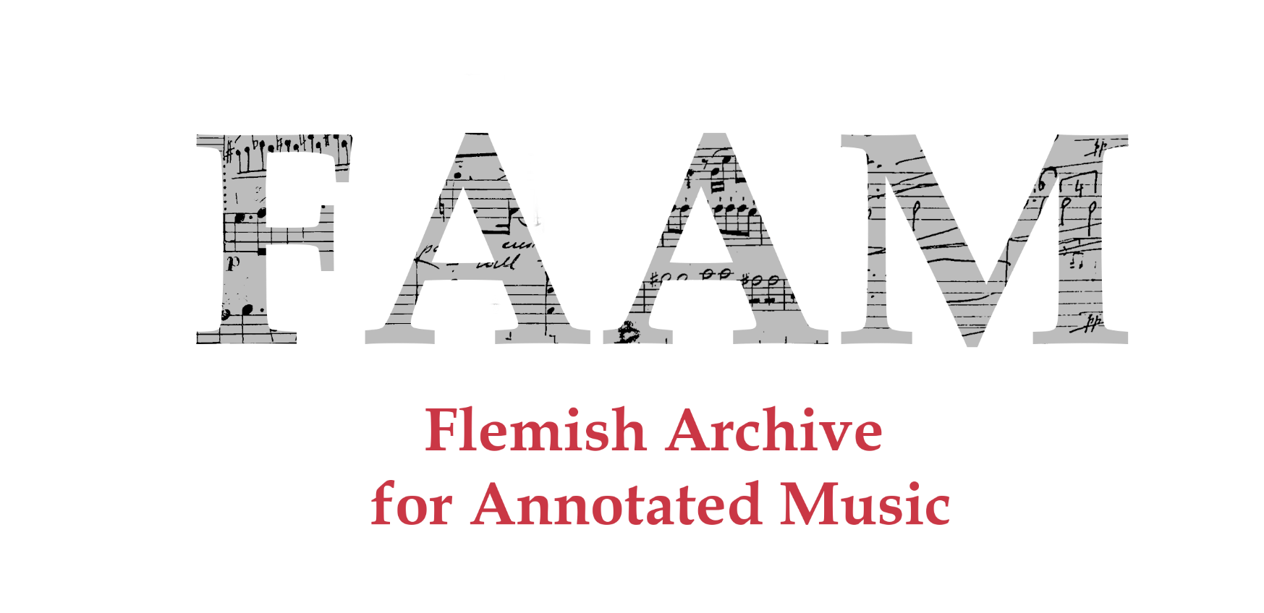


Nicholas Cornia, Hannah Aelvoet
Royal Conservatoire Antwerp, Labo XIX & XX
nicholas.cornia@ap.be, hannah.aelvoet@ap.be
José Oramas
University of Antwerp, imec-IDLab
jose.oramas@uantwerpen.be
Notes:
3,5 minutes max per slide – for a total of 60 minutes (10 minutes questions)

Slide 2
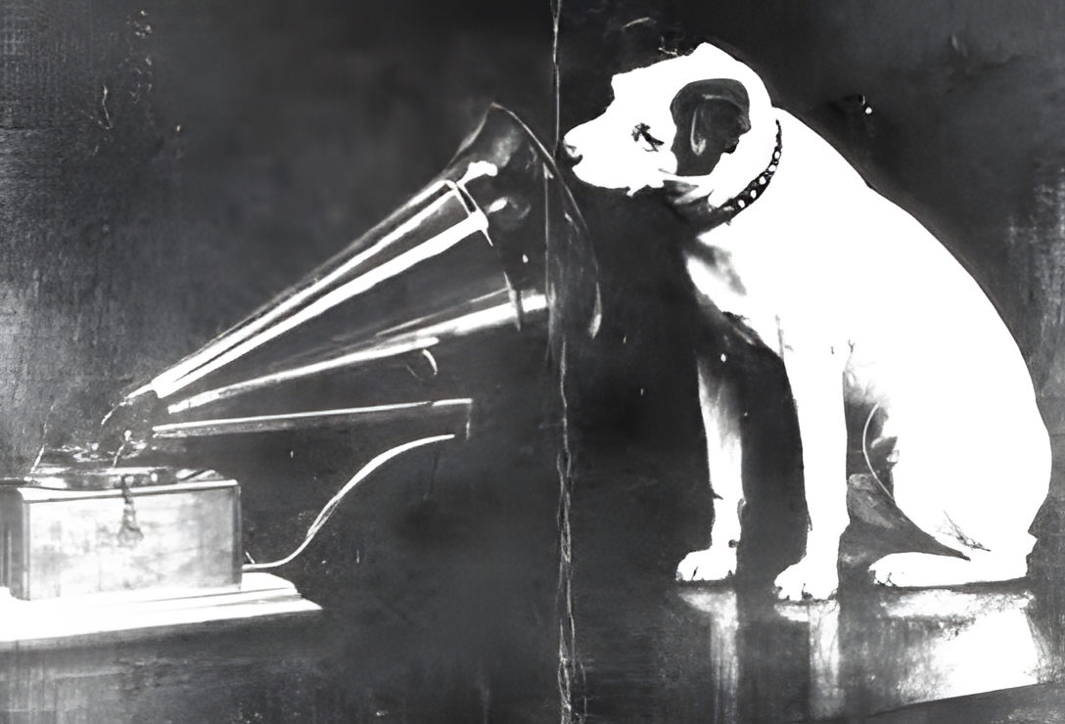
The genesis of FAAM
Valentine Degive-LeDelier (1846-1912) annotated songs collection
Recollecting the performance practice of pre-recording era musicians
Agency of the scribe and interpretation of musical work
Scores with annotations are usually neglected by librarians during digitization process.
Notes:
Consider early recordings of Caruso, Debussy, Ragtime musicians…
Piano Rolls technology

Slide 3
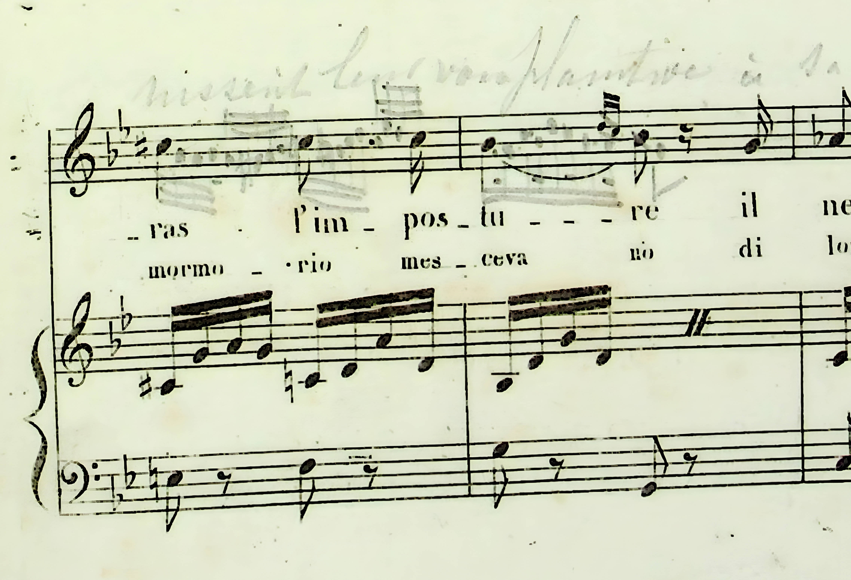
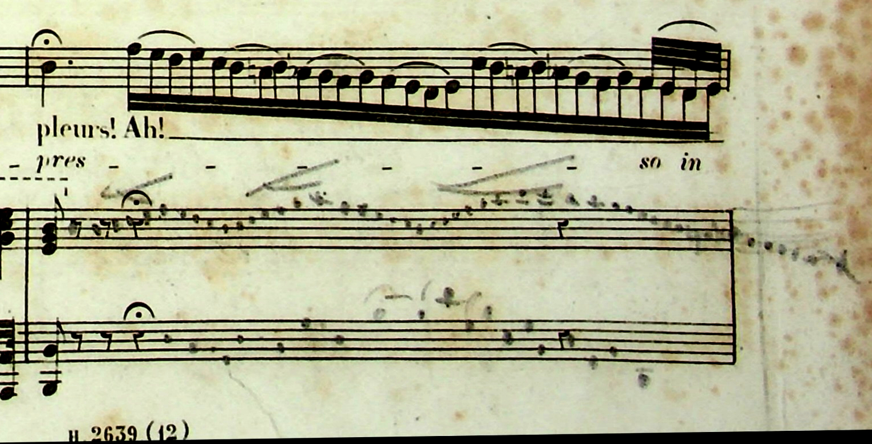
Degive Annotations
In sì barbara sciagura (Gioacchino Rossini – Semiramide, 1823) Version of Barbara Marchisio (1833-1919)
Assisa ai piè di un salice (Gioacchino Rossini – Otello, 1816)
Notes:
Unbroken tradition of embellishments and cadenzas in Early Romantic repertoire
Unfortunately, other genres have lost this agency from the musicians…
Barbara Sciagura – cadenzas
(Simona Genga) https://www.youtube.com/watch?v=ARzr1rbGI8c (3 minutes)
Assisa ai piè – Embellishments and custom French lyrics
(Joyce di Donato) https://www.youtube.com/watch?v=7zk8W4OwjGk (5minutes)

Slide 4
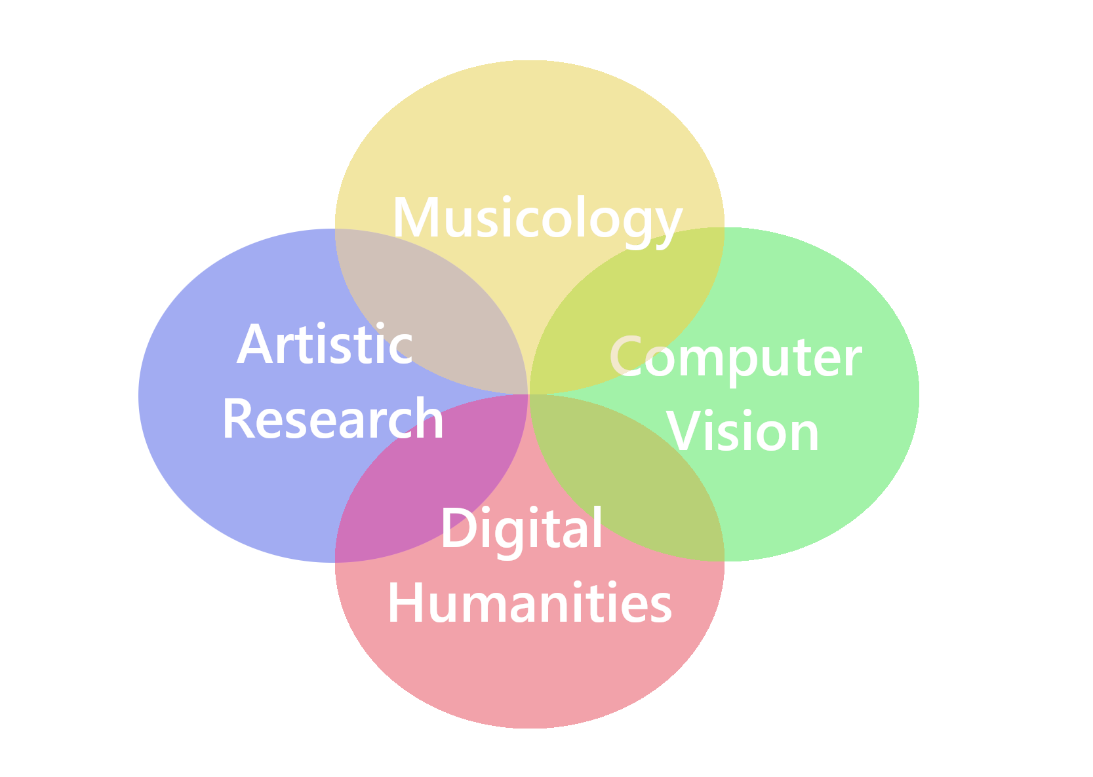
Research Objectives
Computer Vision: creation of a dataset for the Optical Music Recognition and Information Retrieval research communities.
Digital Humanities: Provide a digital platform of handwritten annotated music for performers and researchers in the field of historical performance practice of the 19th and early 20th century within the FAIR and Linked Open Data principles.
Artistic Research: Scores annotated by musicians of the past provide a huge source for understanding the performance practice of the period.
Musicology: Analysis of annotation trends, reconstructing performances and authors’ styles.

Slide 5

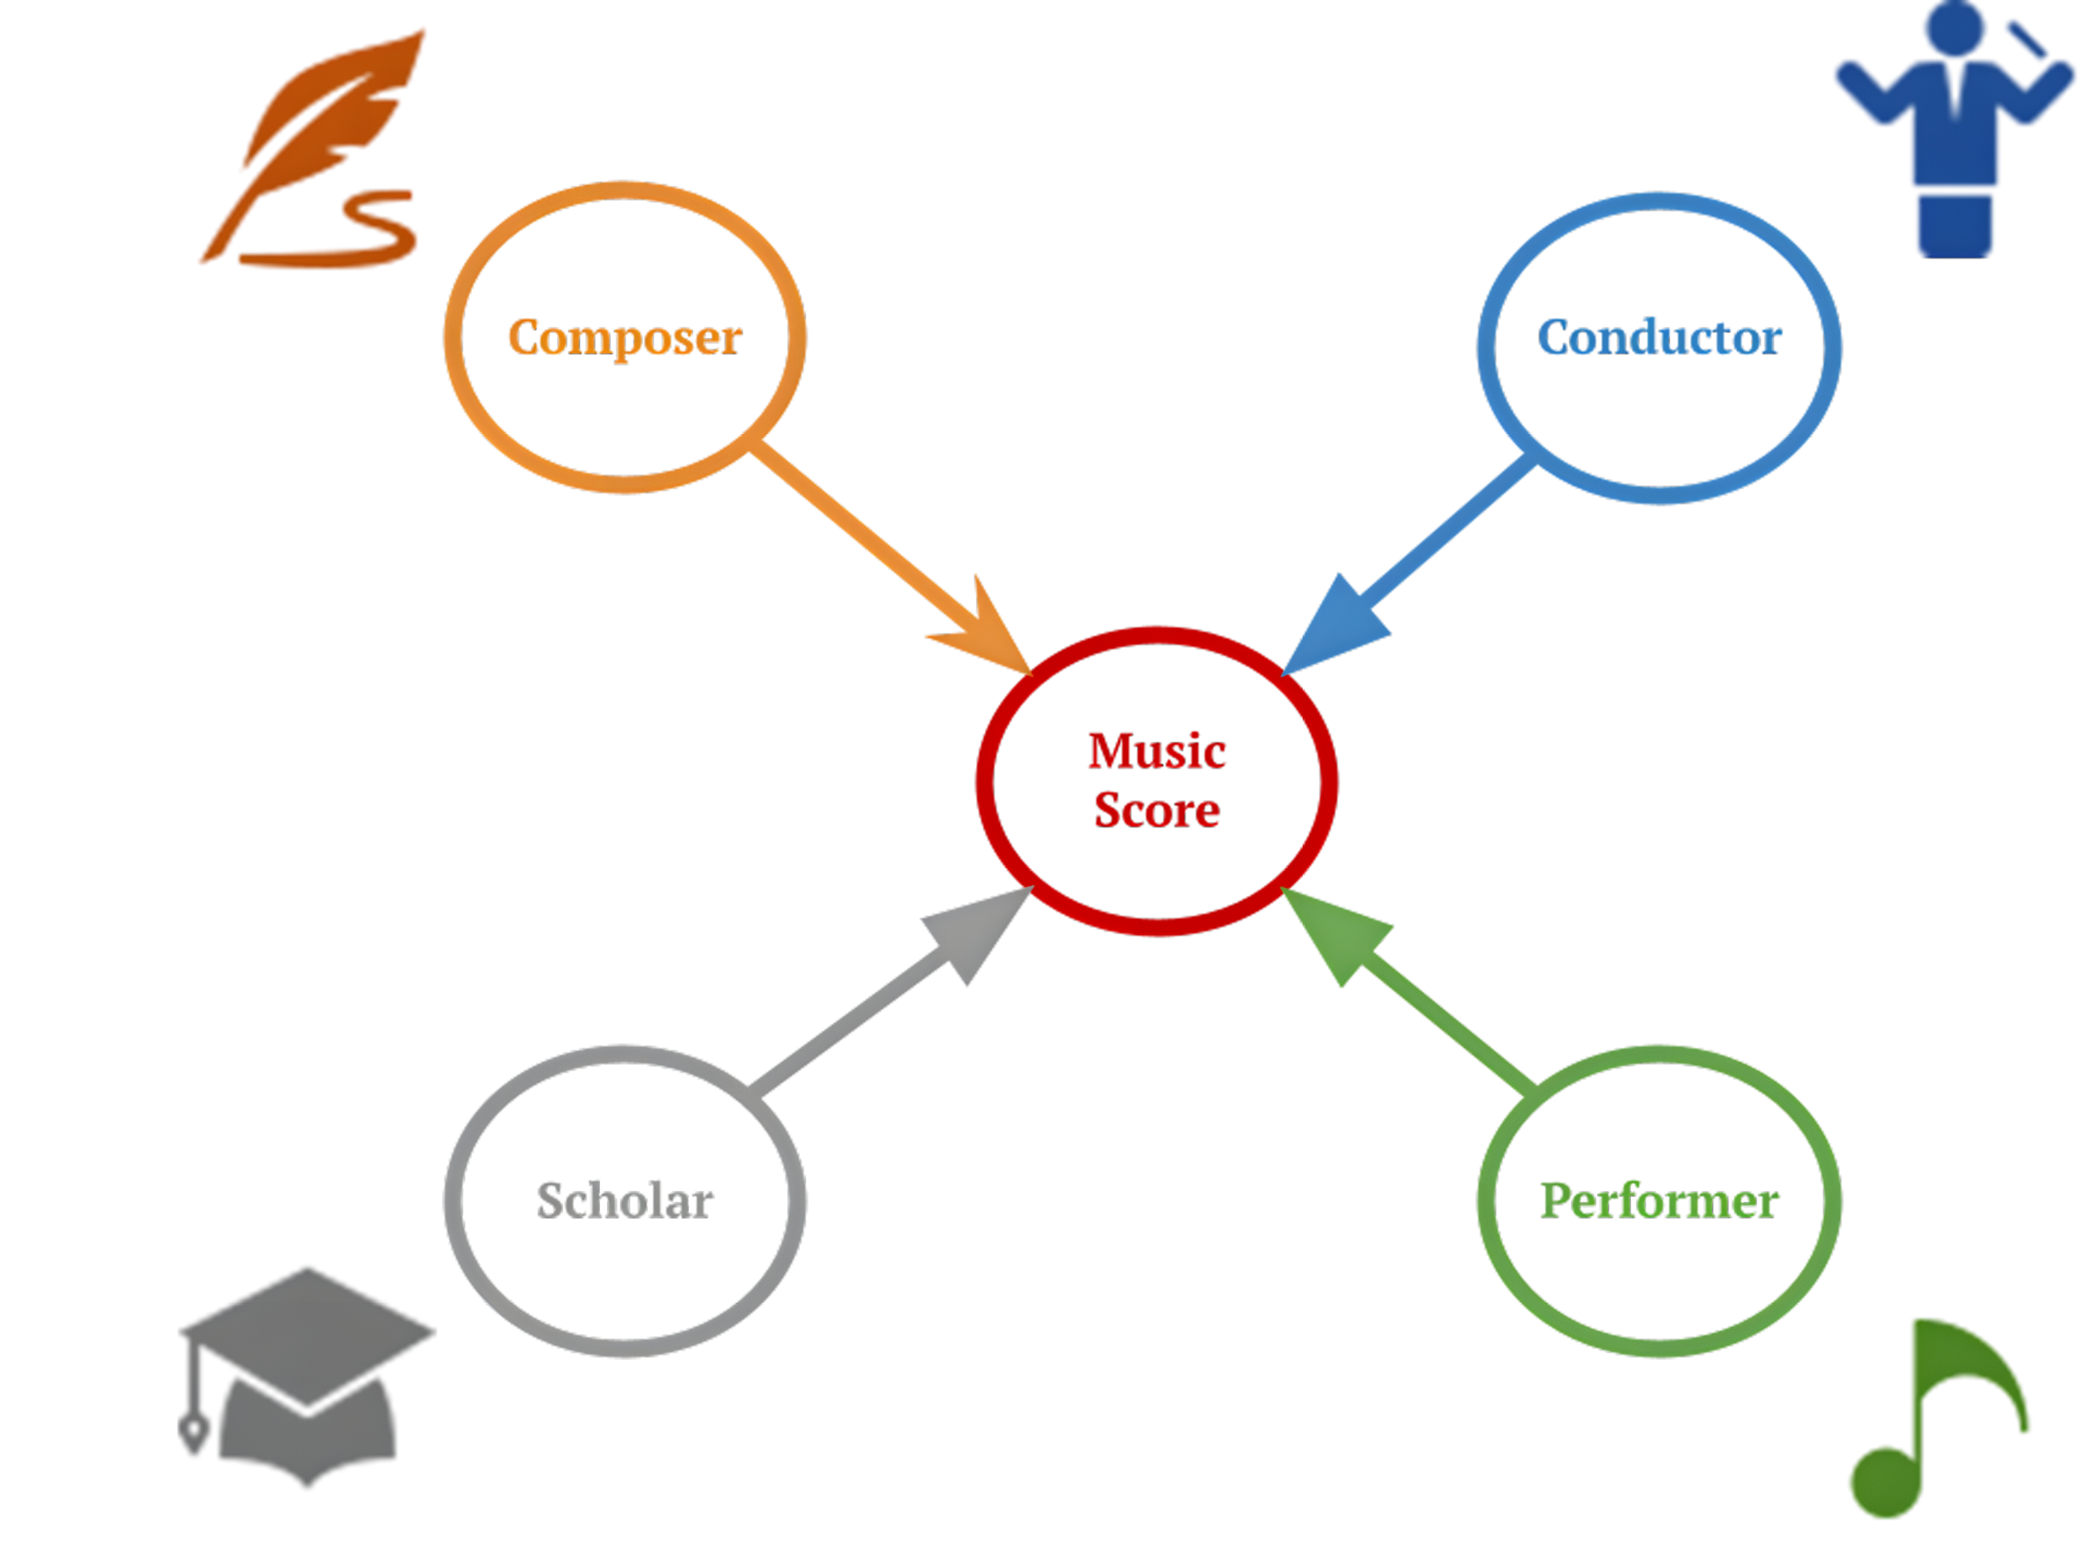



Annotators perspectives
Composer
Conductor
Performer
Scholar

Slide 6
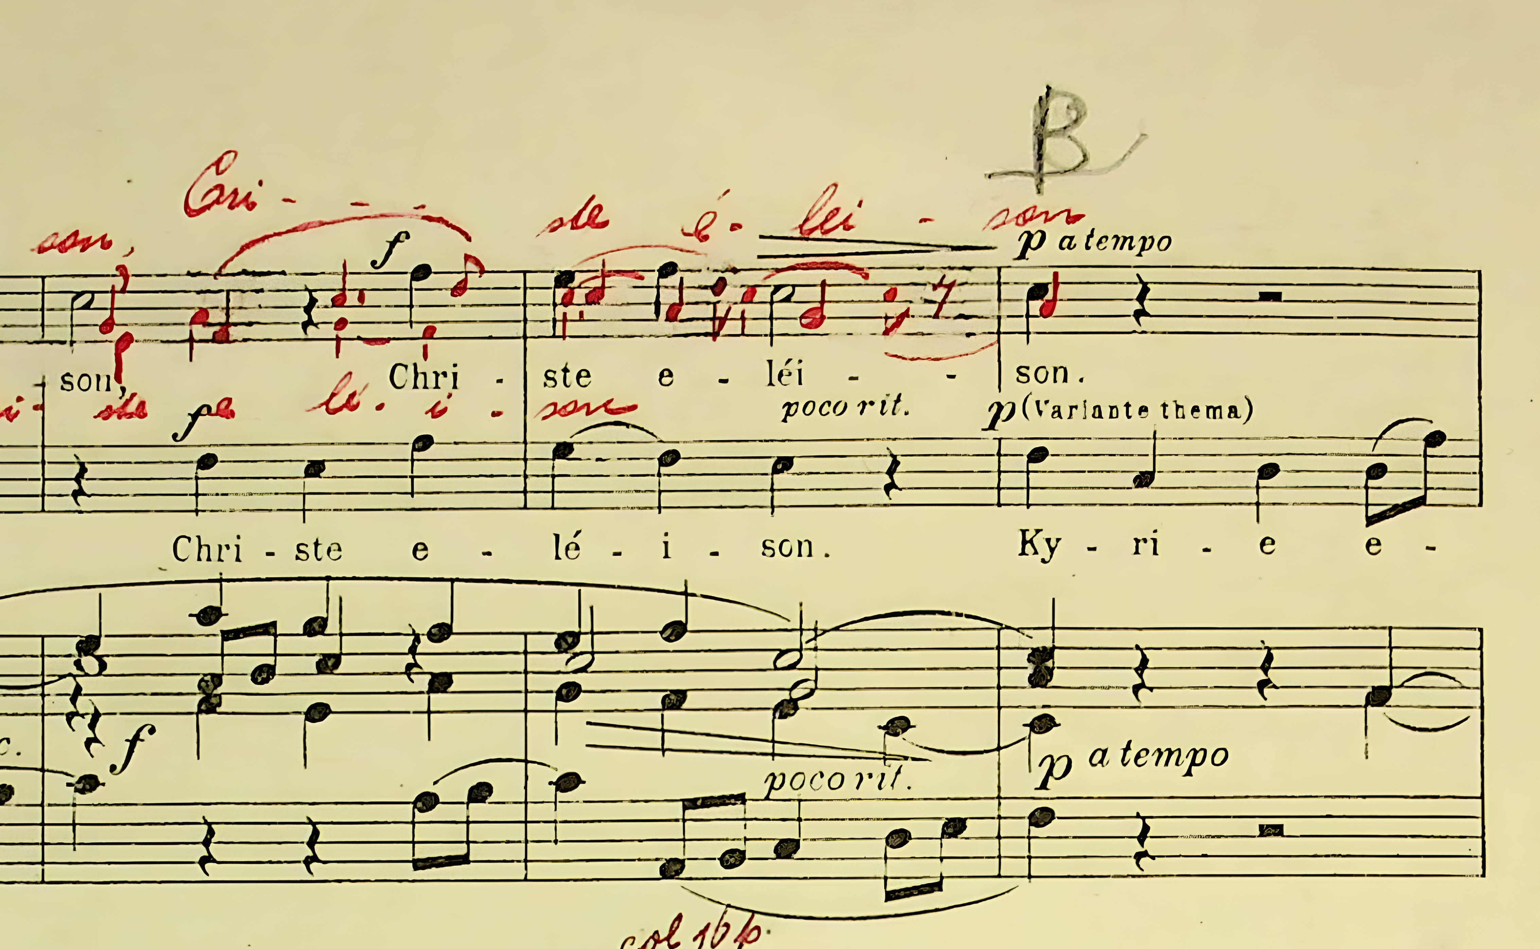
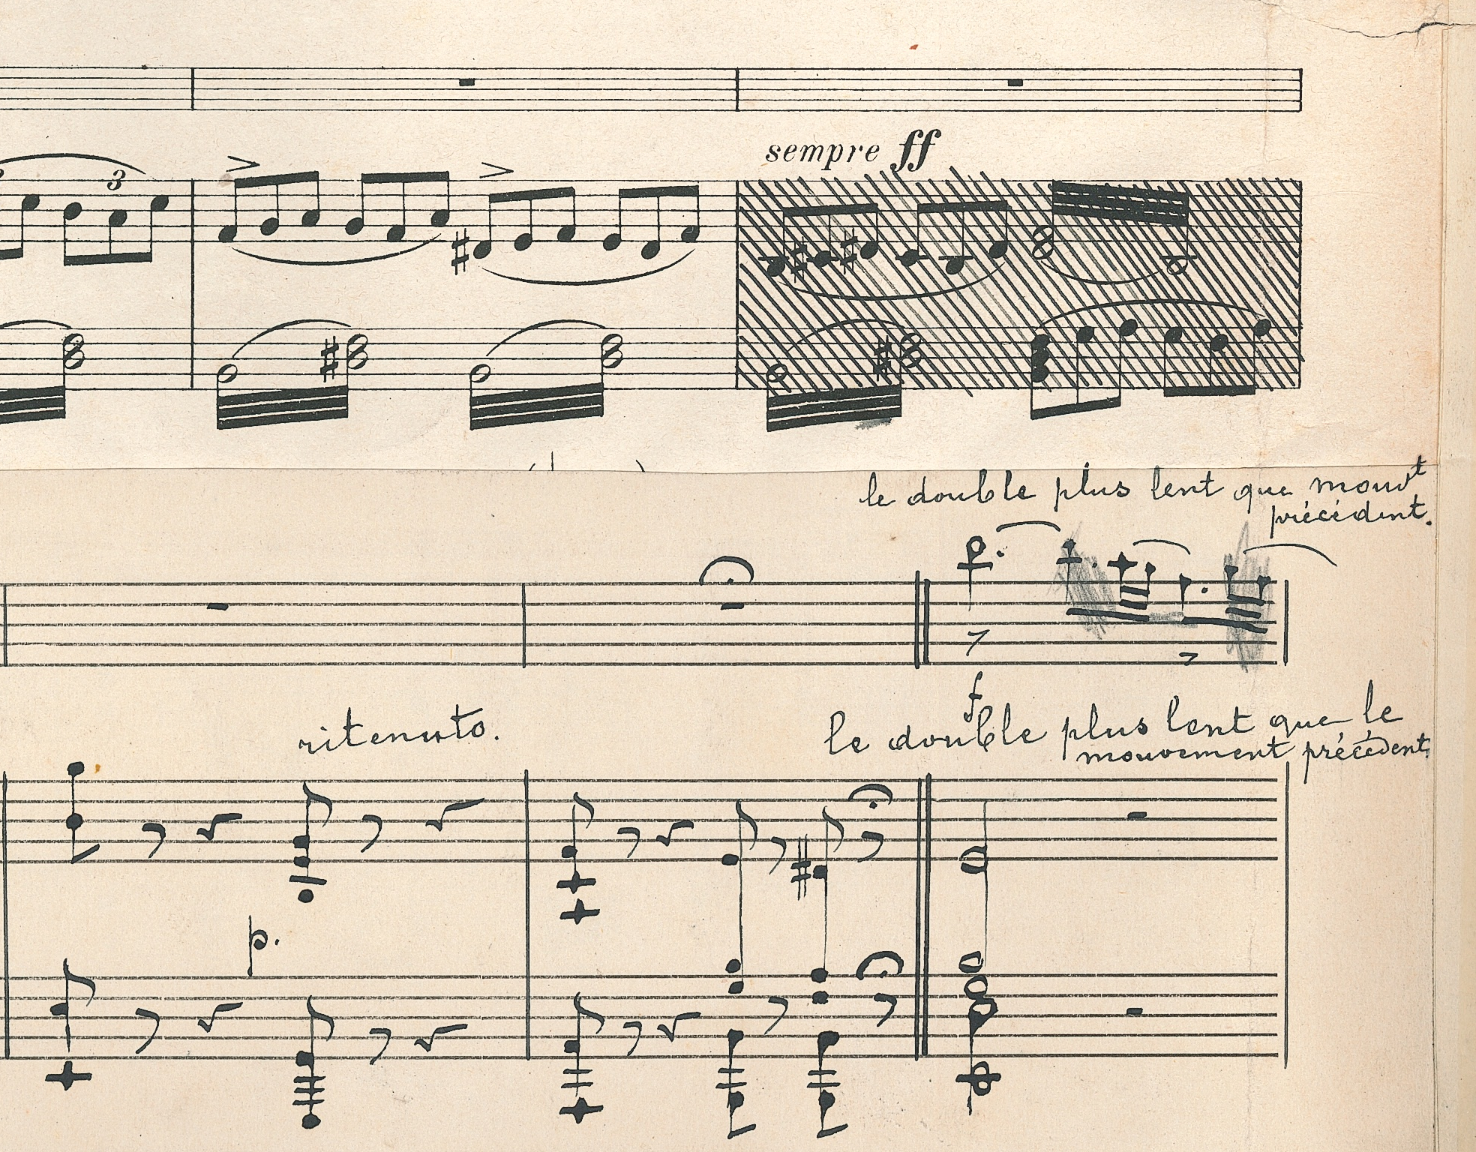
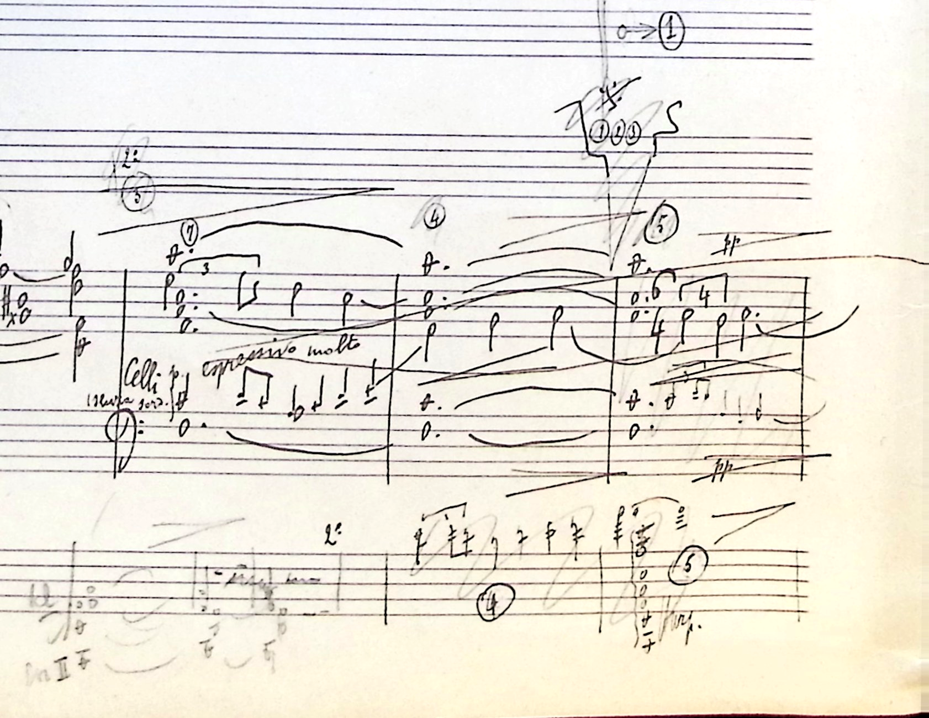
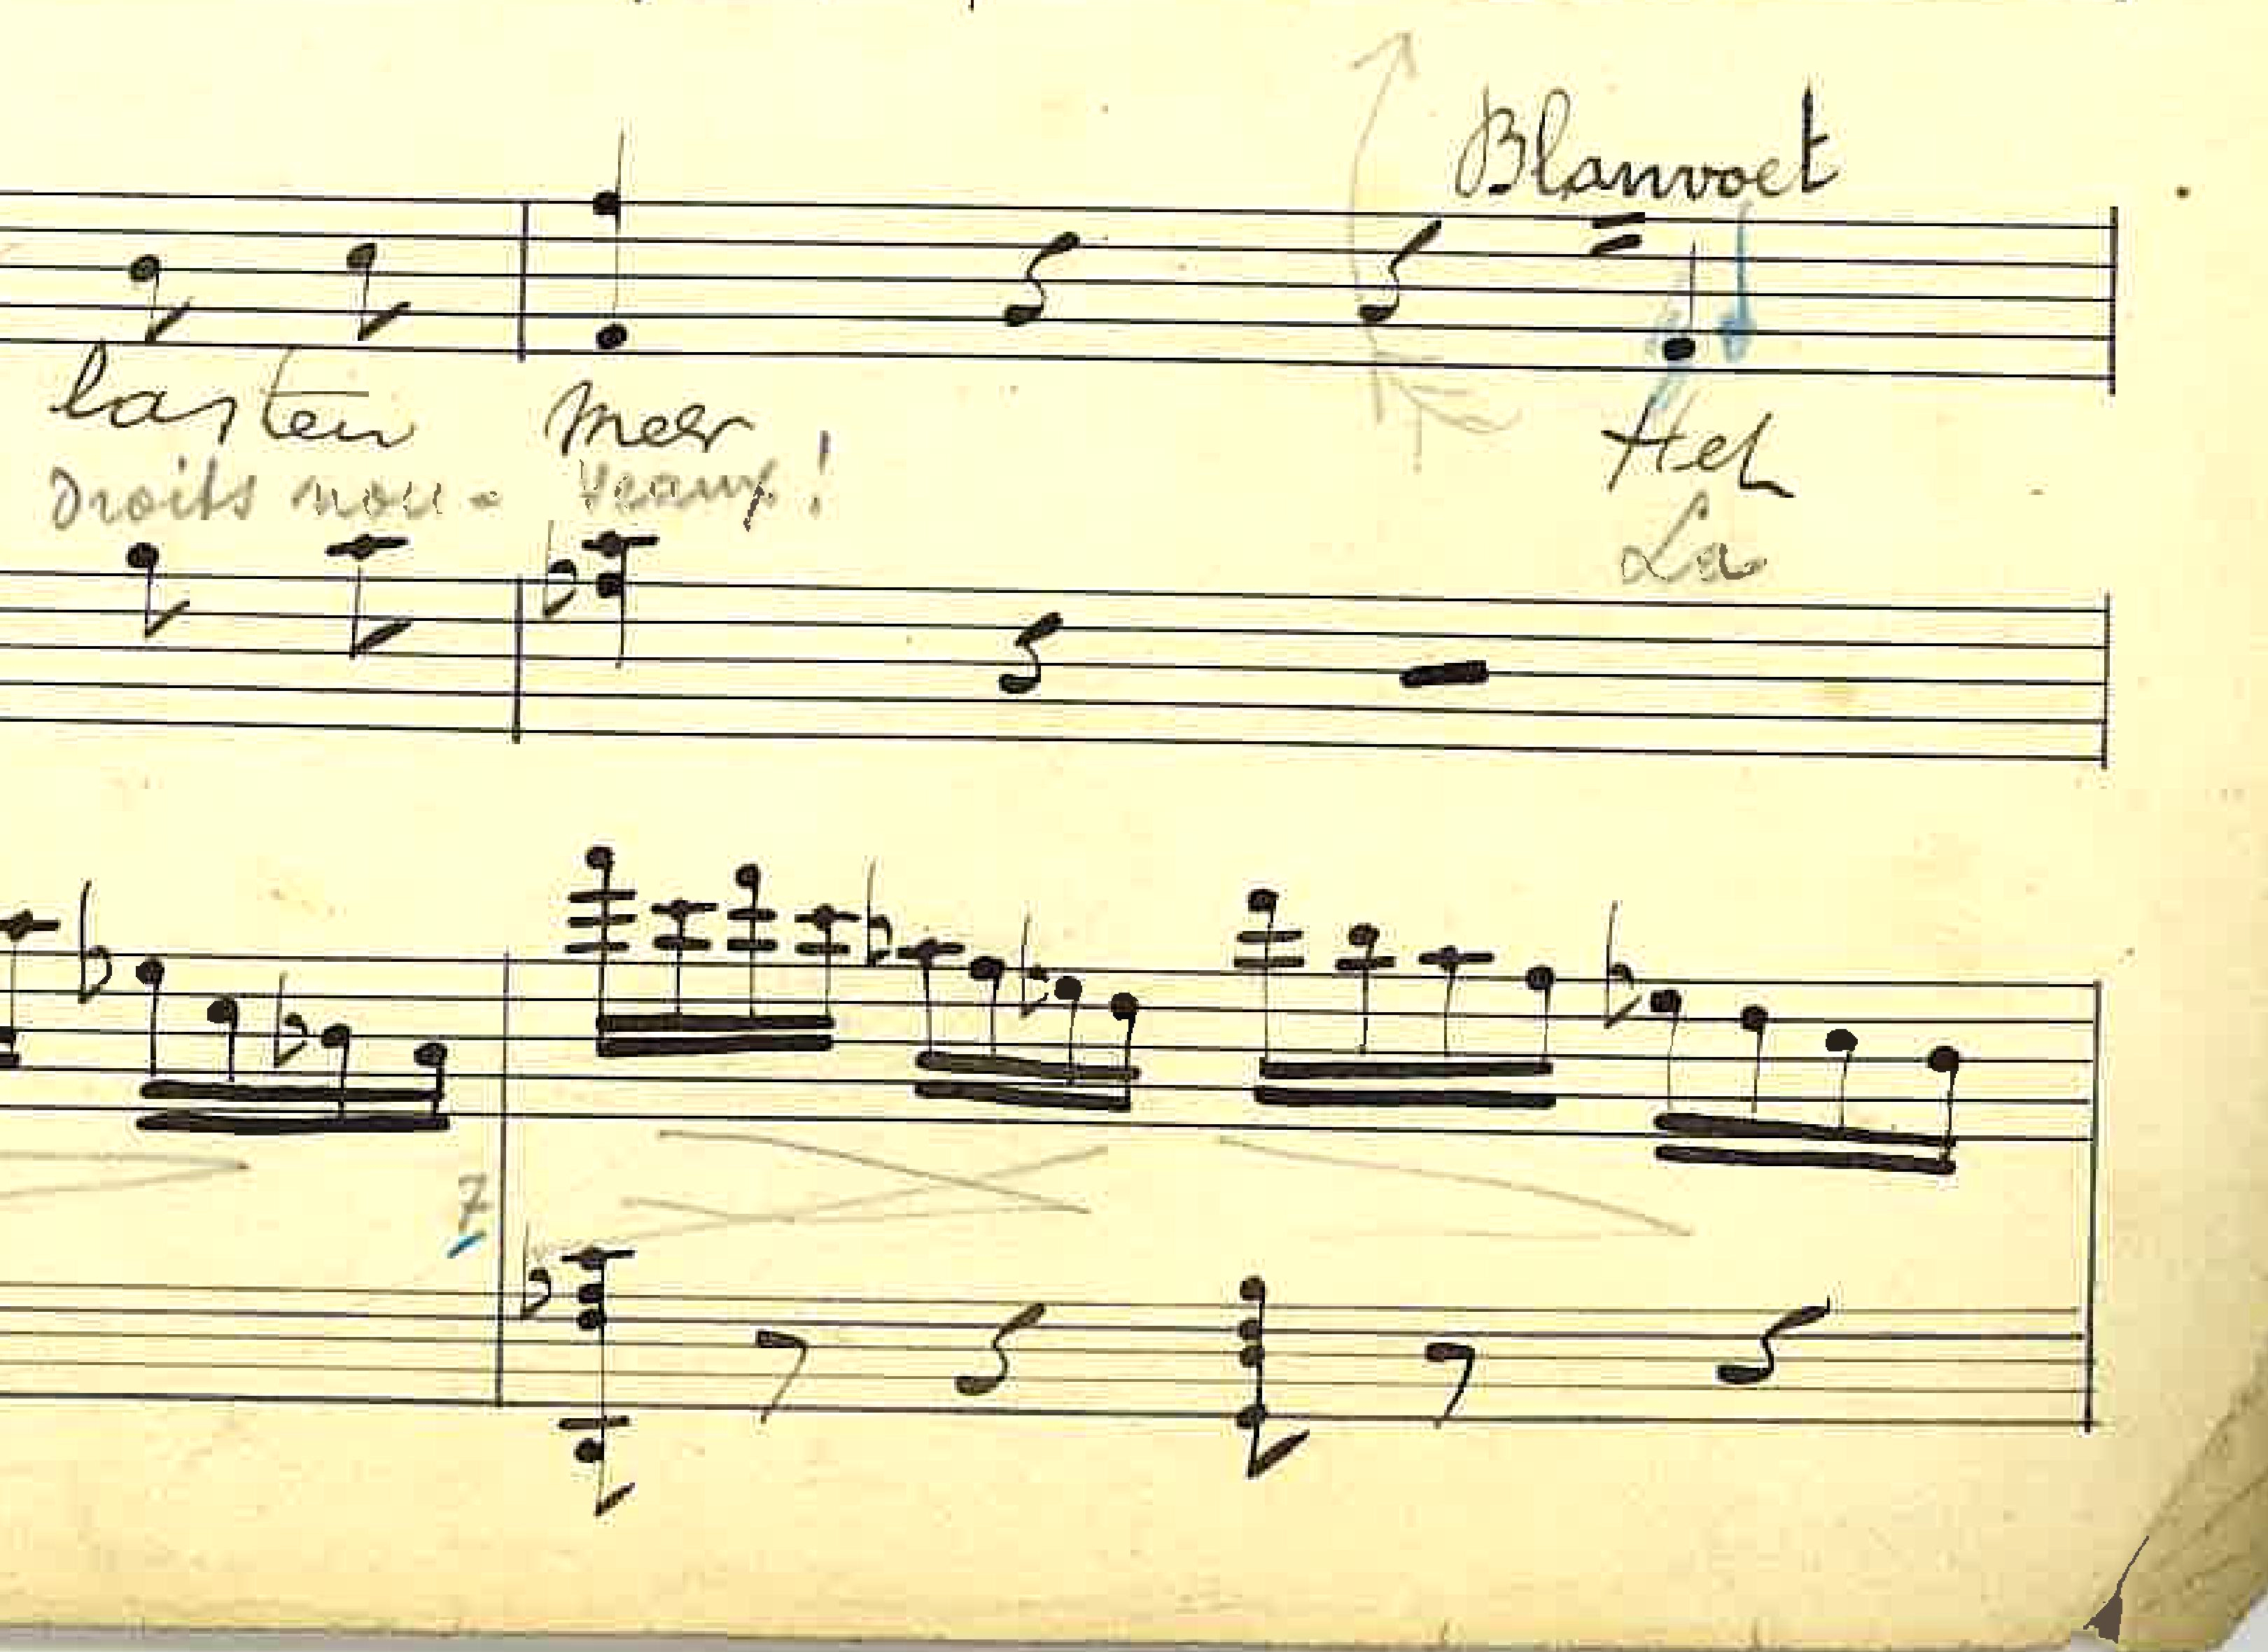
The Composer’s perspective
Recollecting the compositional process and changes made by composer with their own works.
Marinus De Jong (1891-1984) – Missa Ave Maria
Frederik Bonzon (1850-1926) – En Ardennes
Arthur Meulemans (1884-1966) – Beatrijs: Sinfonisch Poema
August De Boeck (1865-1937) – Reinaert de Vos
Notes:
Belgian pianist and composer of Dutch origin. After taking Belgian nationality he studied composition with Lodewijk Mortelmans and the piano with Emile Bosquet at the Antwerp Conservatory. He began his career as a piano virtuoso, touring Europe and the USA. Piano teacher at Antwerp Cons from 1931
The Dutch-born oboist and composer Frédéric Bonzon was the conductor of the band of the Chasseurs-Éclaireurs d’Anvers – Piece written for the 50th anniversary of the corp in 1910.
Arthur Melemans Flemish composer and conductor, studies in Lemmensinstituut in Mechelen. Sketches with date of 1911.
Julianus Marie August De Boeck was a Flemish composer, organist and music pedagogue. He was the son of organist and director Florentinus (Flor) De Boeck (1826-1892). Studies at Brussels cons.
Reinaert de Vos (1909) Opera in 3 acts.

Slide 7

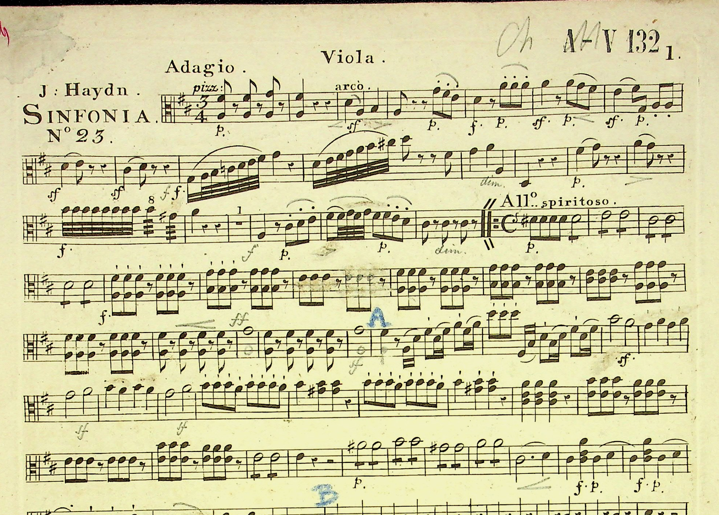
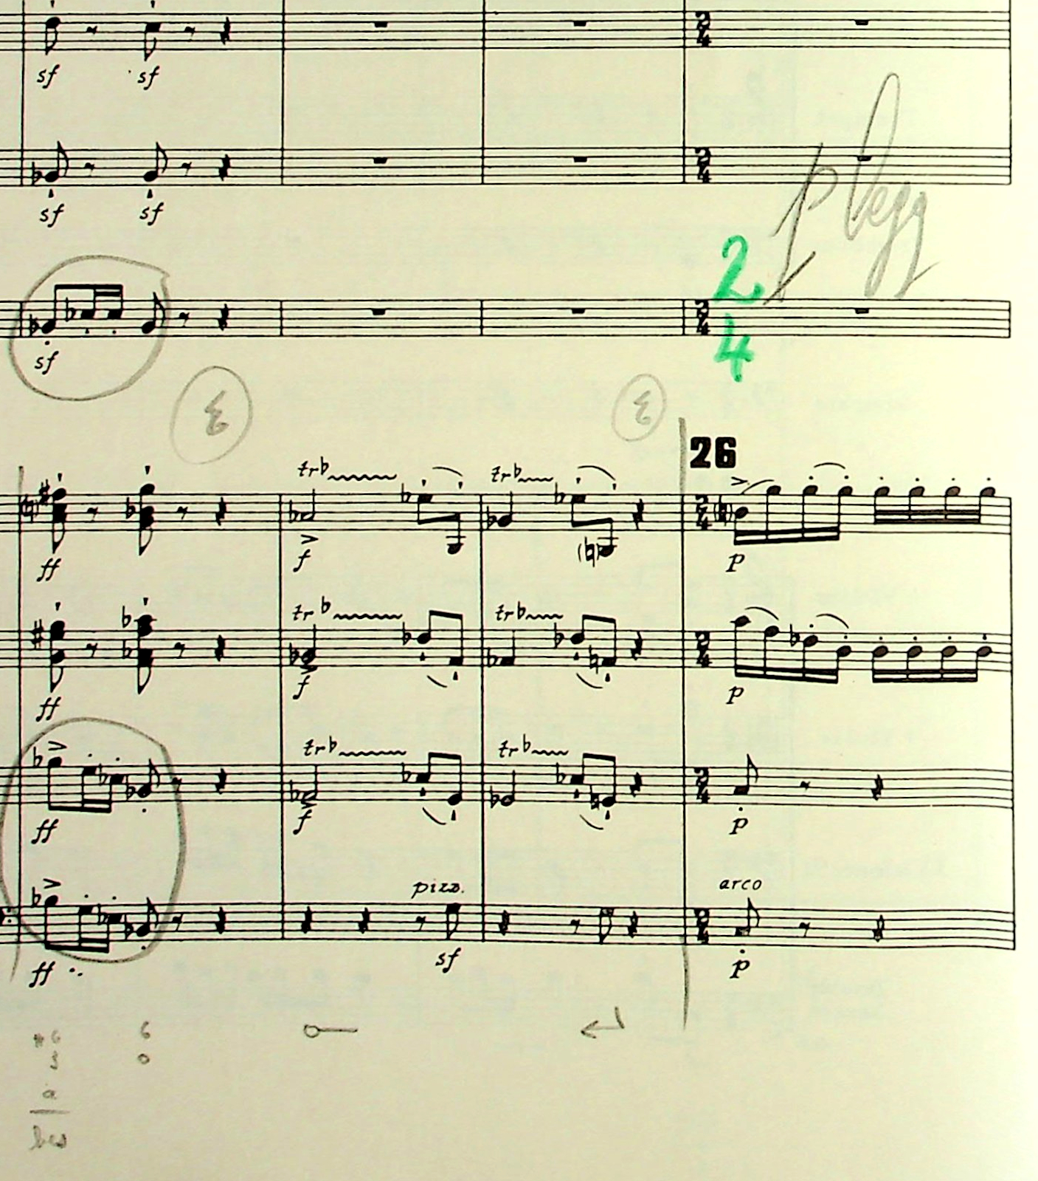
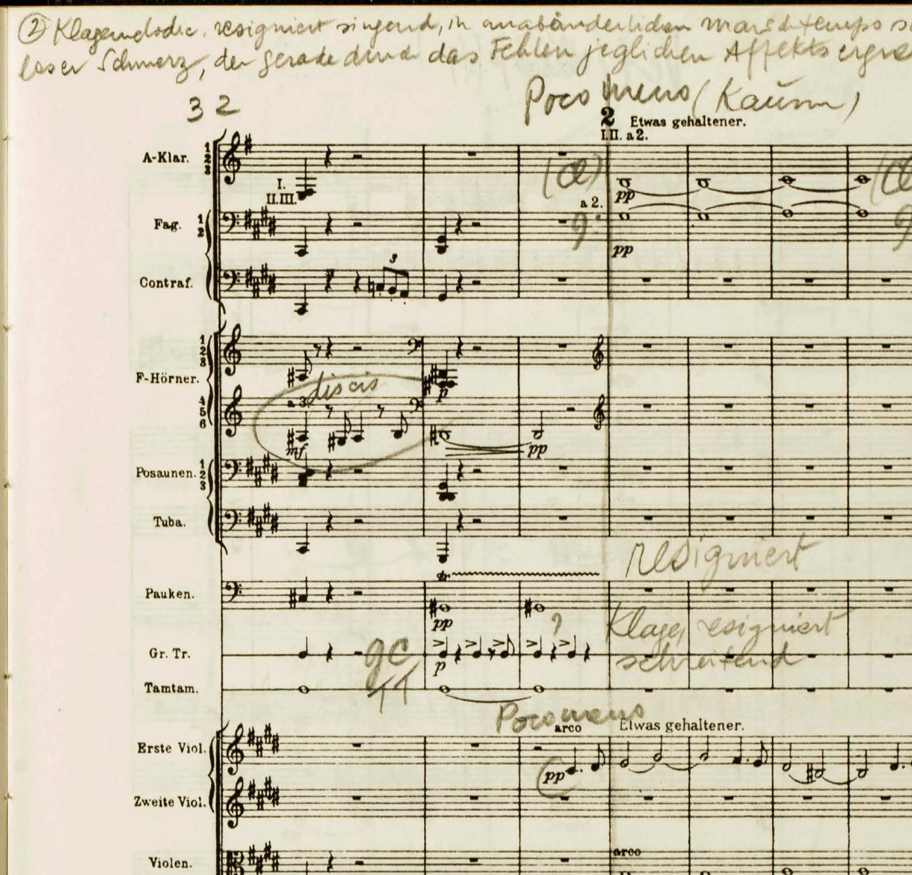
The Conductor’s perspective
Conductor’s choices and instructions. Styles of markings.
Karel Miry (1823-1889) Haydn’s Symphony N.23
Igor Stravinsky (1882-1971) Dances Concertantes
Maurice Abravanel (1903-1993) Mahler’s Symphony N. 5 Mov. I
Notes:
Karel Miry, belgian composer who studies at the Ghent Conser with Joseph Mengal and in Brussels with Francois-Auguste Gevaert.
Teacher in Ghent from 1857
(12 August 1858, Ghent Conservatoire Orchestra)
Detailed marks and interpretation made on each part for the students.
Igor Stravinsky
(3 February 1942, Janssen Symphony Orchestra)
Composer performing and chaning his own work
Maurice Abravanel American conductor at Utah Symphony Orchestra from 1947, born in modern day Greece. He had to flee from Germany due to the Nazi persecution of Jewish people.
Collection of recordings and annotated conductor scores.

Slide 8
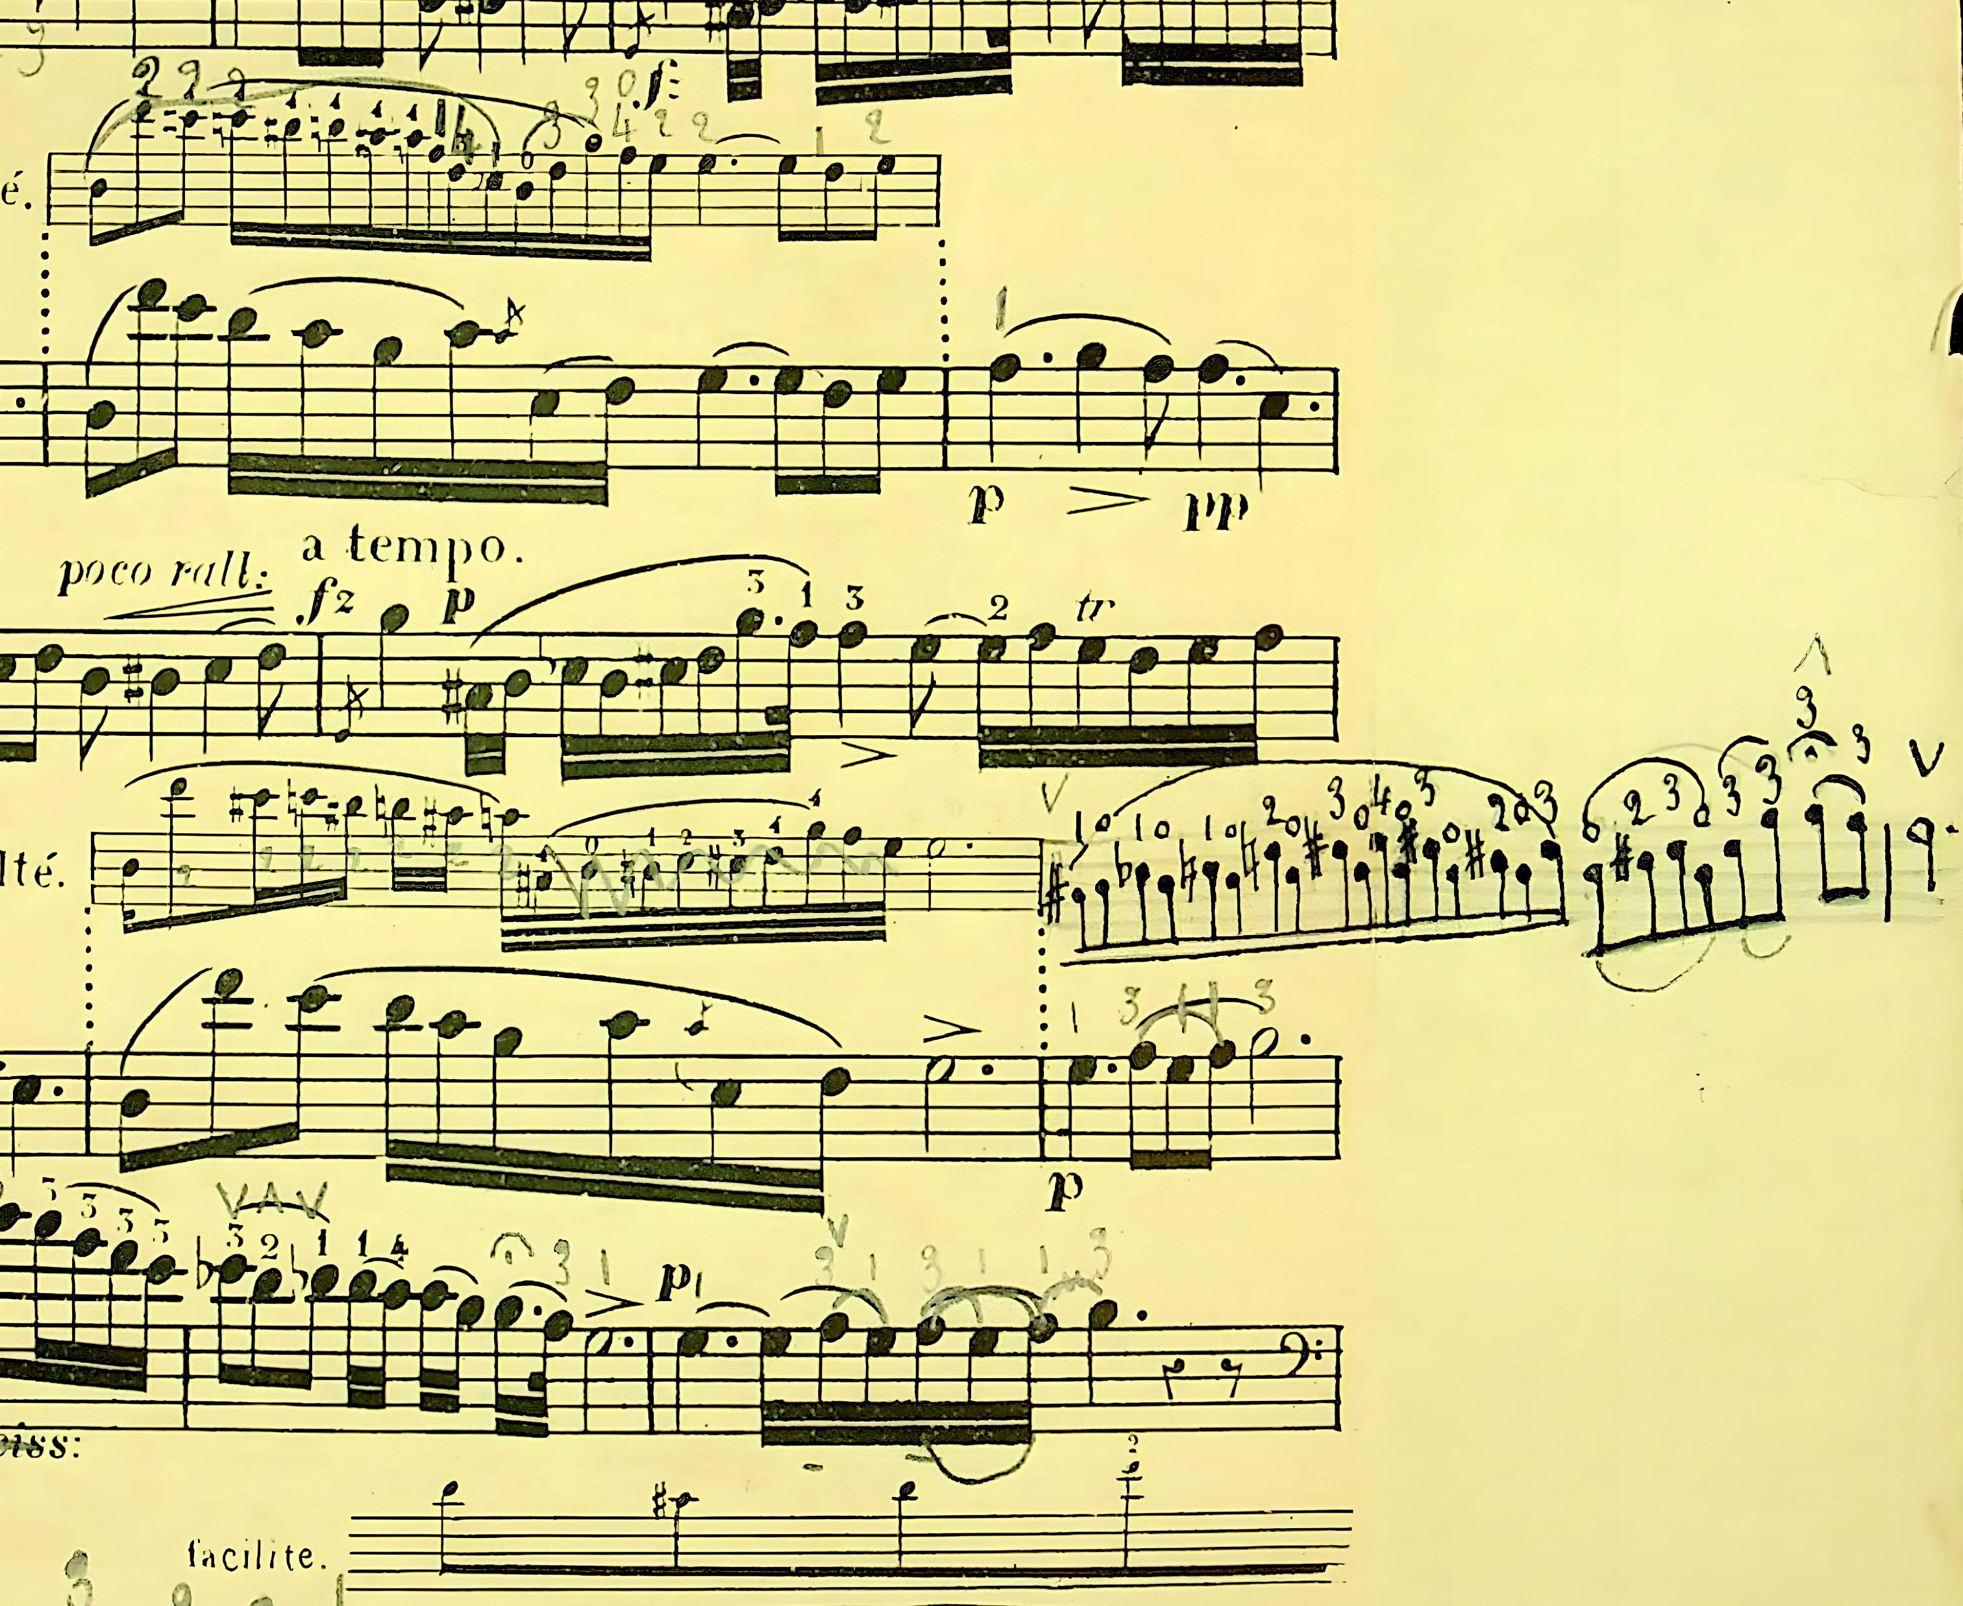
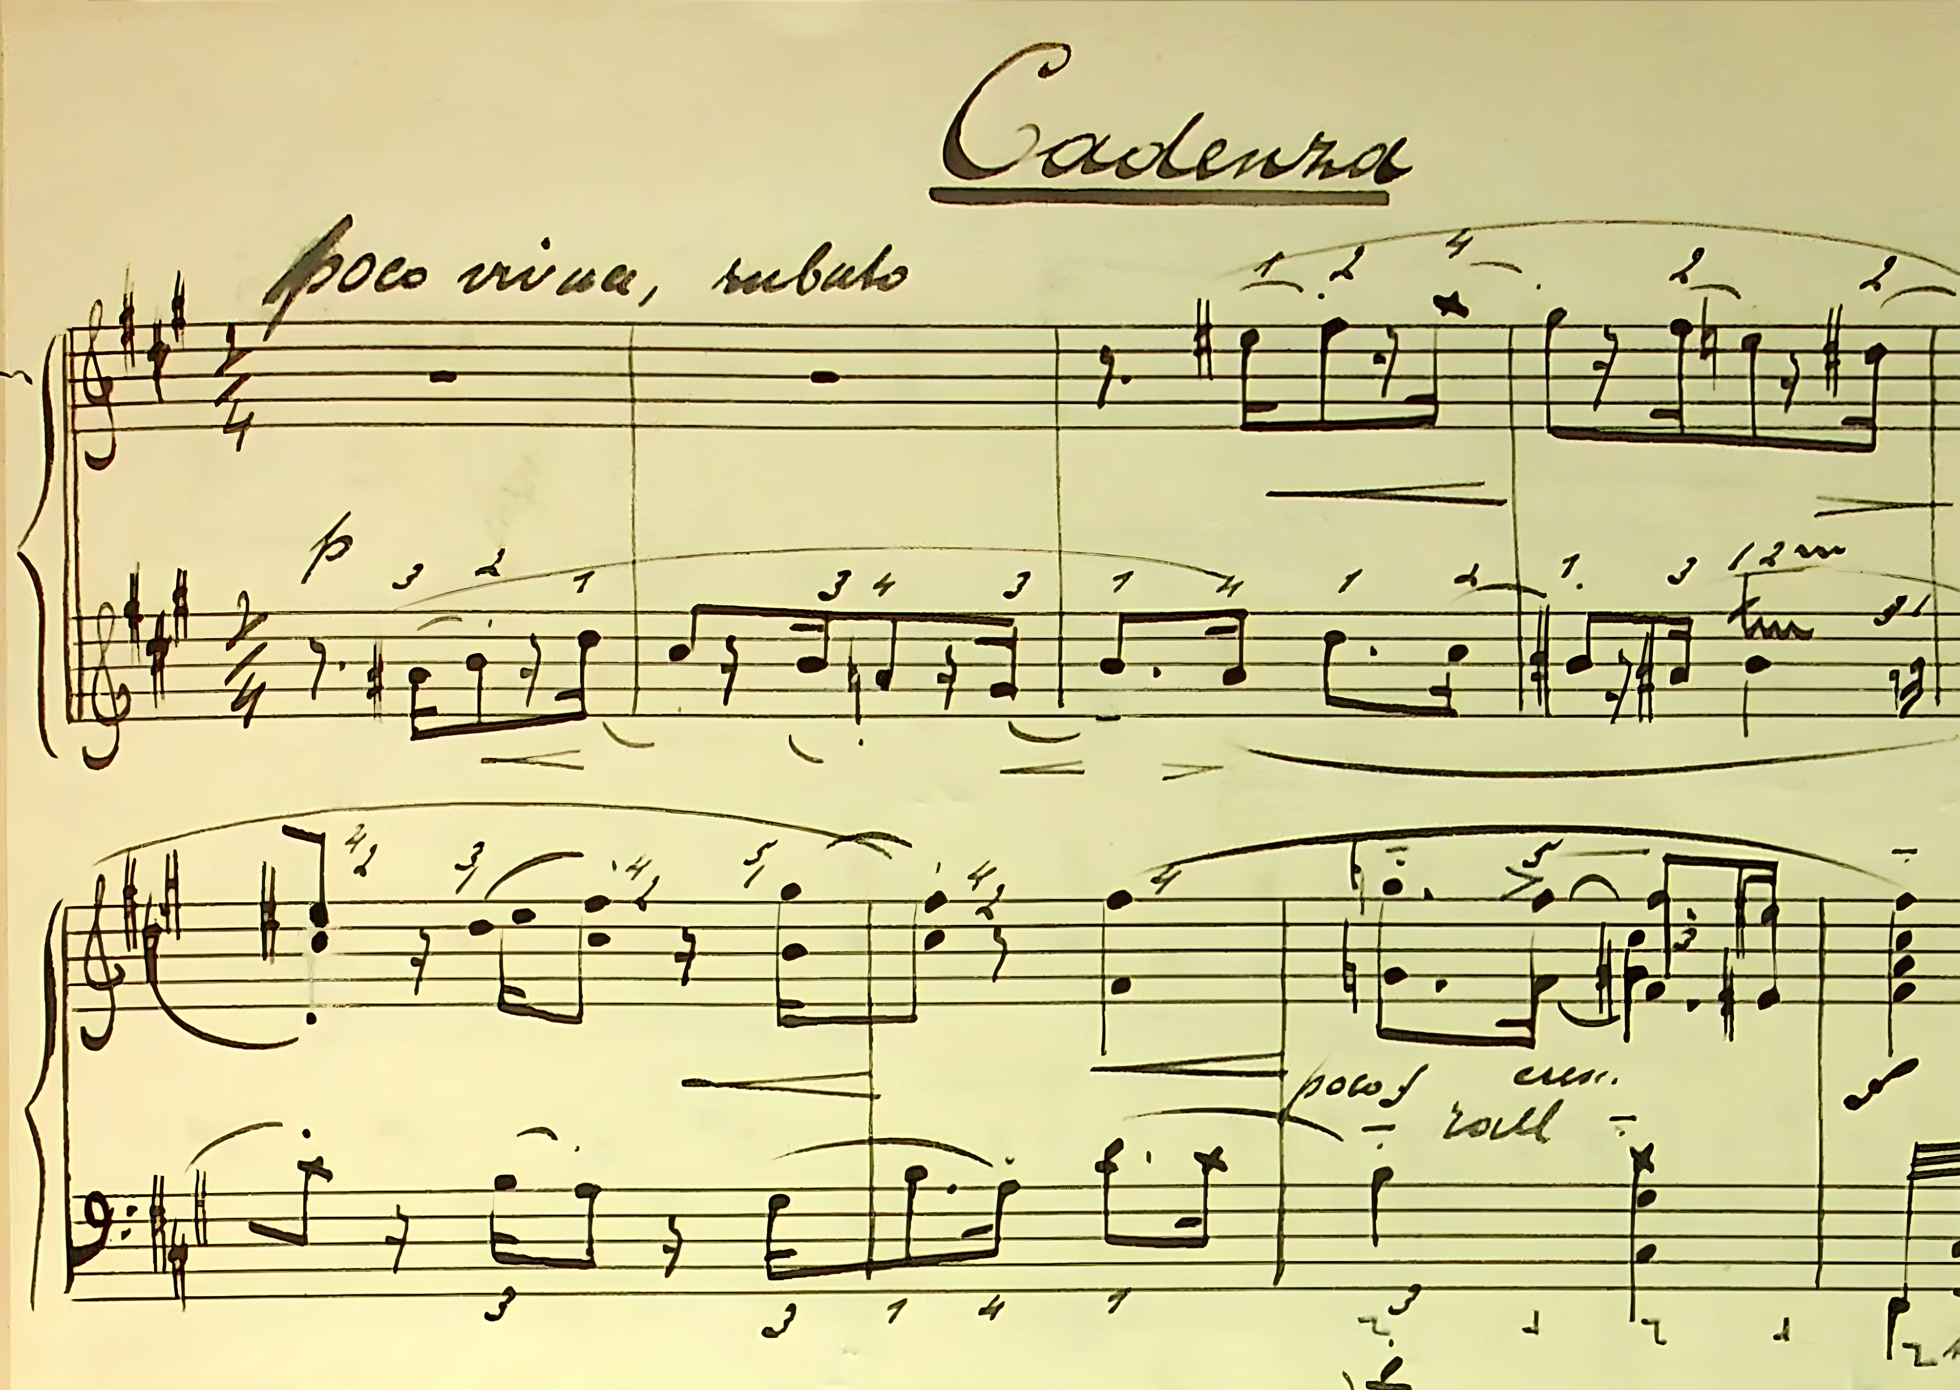
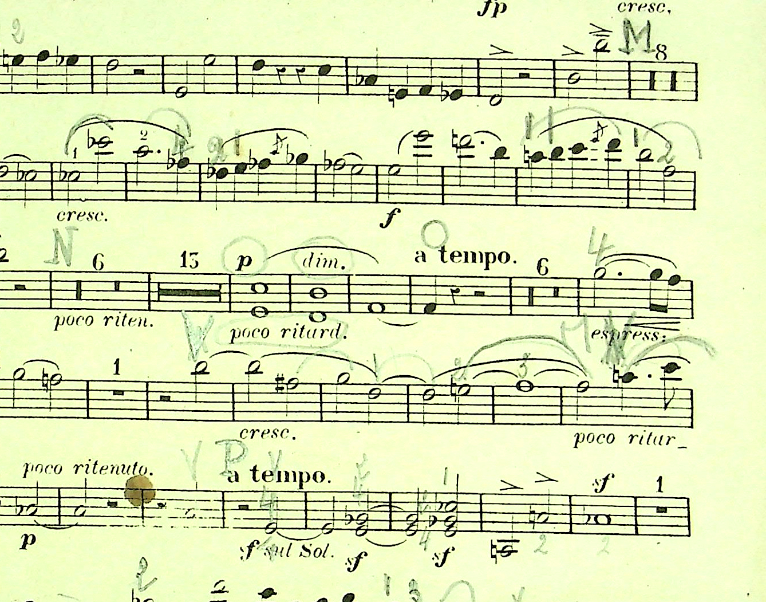
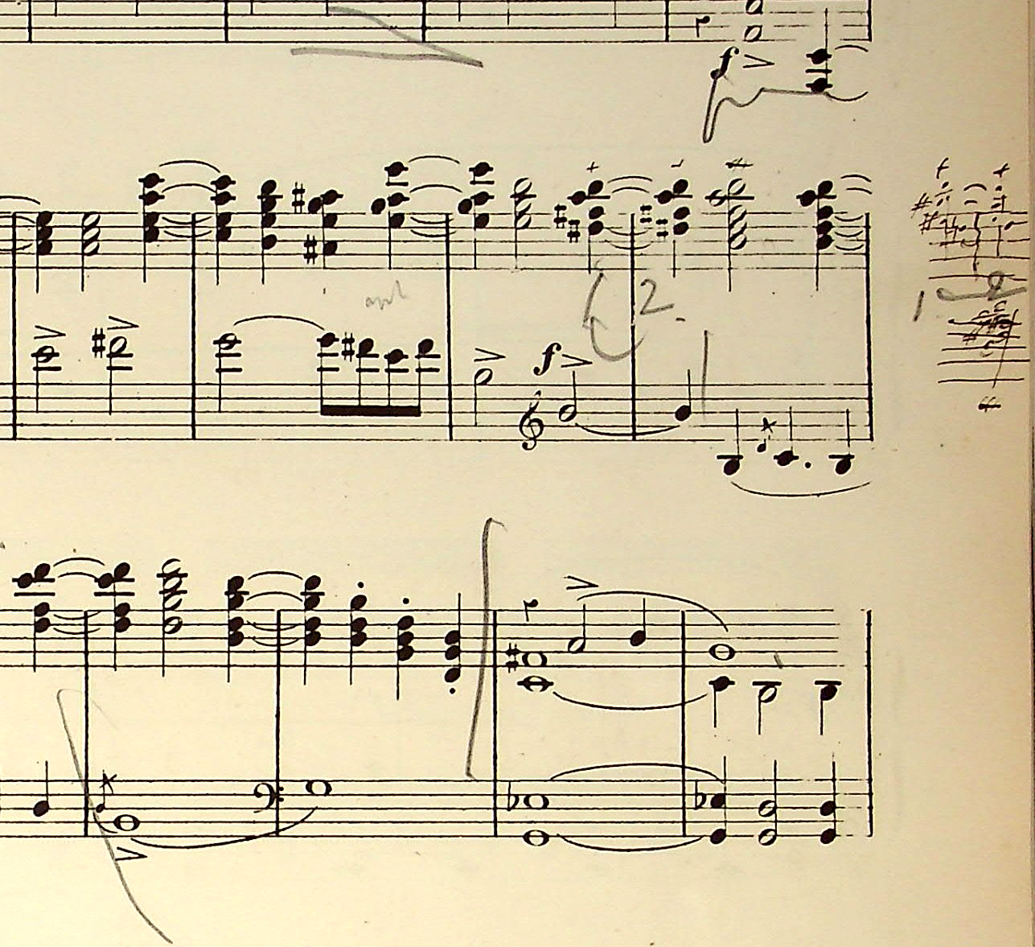
The Performer’s perspective
Retrieving the performance practice of pre-recording era musicians.
Léa Fauquel (?) – Servais’ arrangement of Chopin Nocturne Op. 9 N. 2
Marinus De Jong – Liszt’s Hungarian Rhapsody N. 2
Ghent Conservatoire students (1872 class) Schumann Piano Quintet Op. 44
Lode Backx (1922-2010) – Benoit Contes et Ballades Book 2 N. 3
Notes:
Léa Fauquel – Adrien-Francois Servais (1807-1866) arrangement of Frederic Chopin Nocturne Op. 9 n. 2
(February 1872)
Lode Backx studies piano at the Antwerp Conservatoire, with Marinus De Jong as teacher. Degree in 1942.

Slide 9
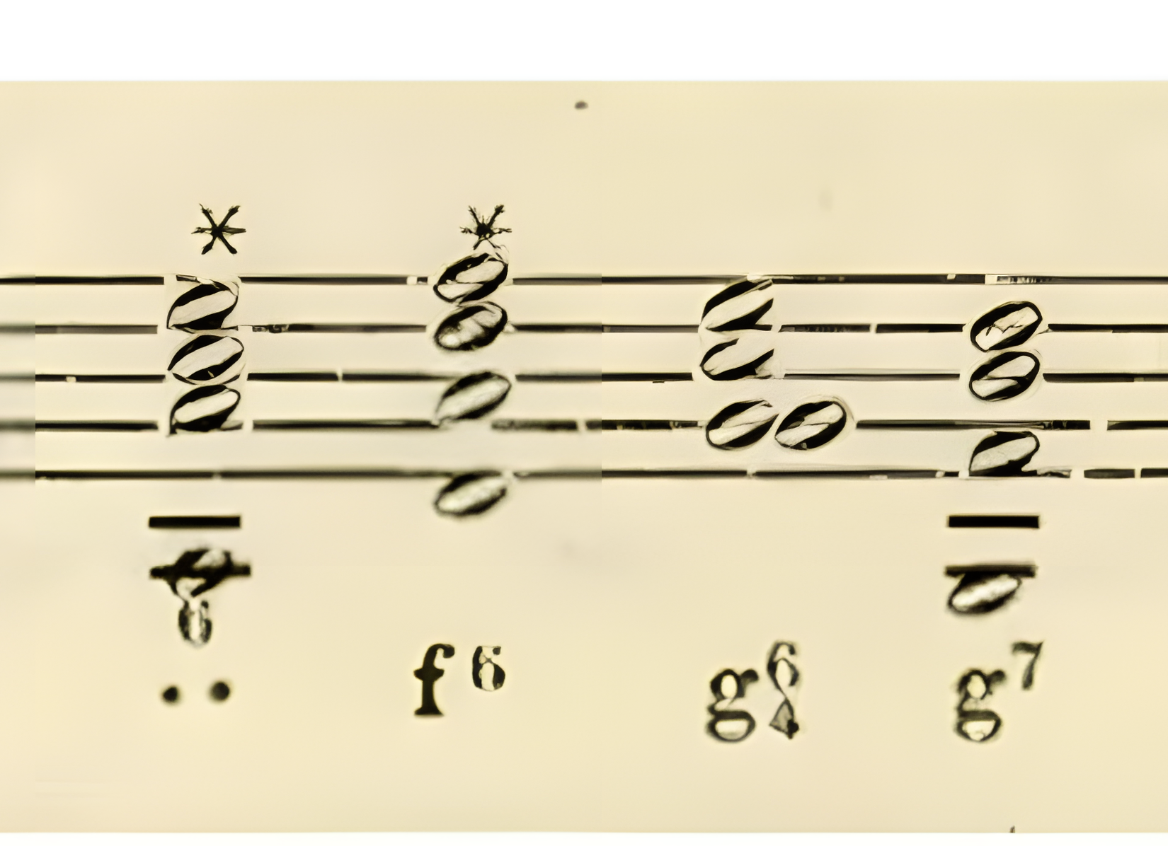
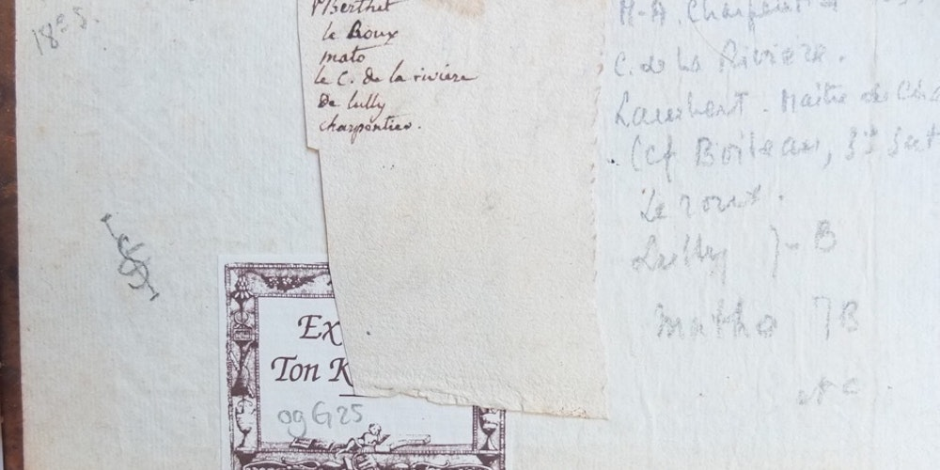
The Scholar
Scholars, like musicologists, historians, libriarians, pedagogues and music collectors intensively annotate music scores for various purposes, such as cataloguing.
Ton Koopman – Orpheus Insitute Resounding Libraries project
Moss, Lopew, Köster and Rizo (2022) 19MT-OMR: a dataset for multimodal Optical Music Recognition

Slide 10
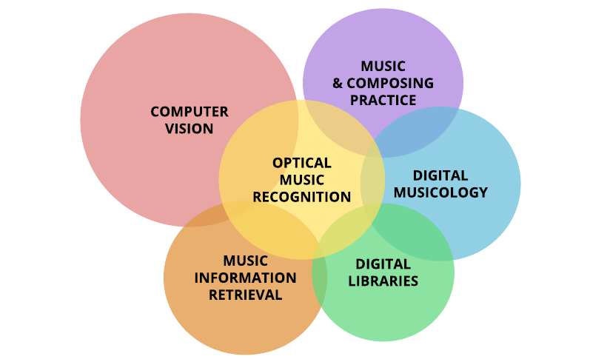
State of the Art
Annotated scores: Bell and Pugin research of conductor’s scores of the New York Philharmonic Orchestra (2016-19)
CHASE project of annotated scores for strings, led by Clive Brown.
OMR research and SIMSSA by Calvo-Zaragoza, Pacha and Fujinaga groups.
Semantic Web musical projects by the Polifonia research network.

Slide 11
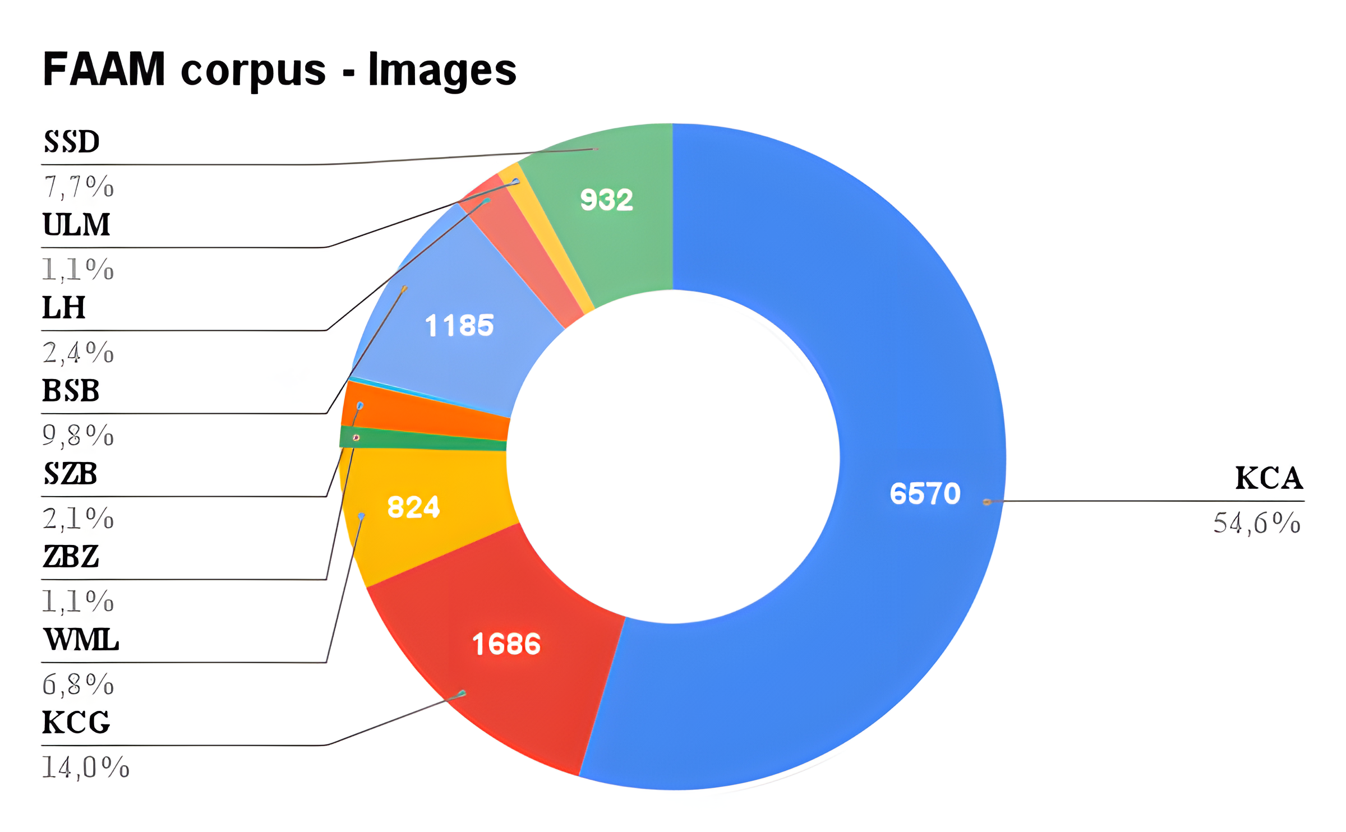
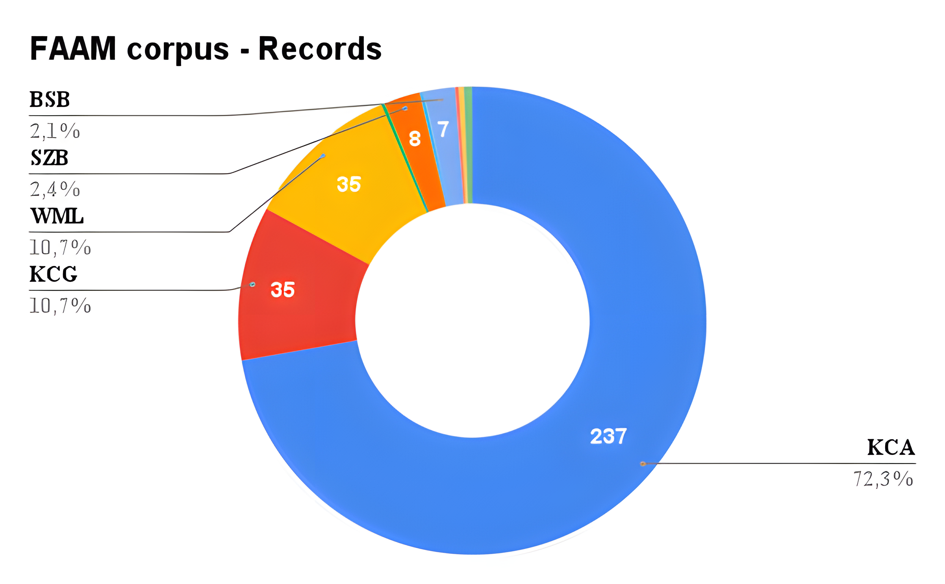
FAAM corpus - sources
Notes:
Total images 12.000
Records 328
We expect the numbers to grow exponentially!
Scanned images 6.651 (more than 80 scans/working day – 80 )
KCA (Royal Conservatoire Antwerp)
KCG (Royal Conservatoire Ghent)
WML (J. William Marriott Digital Library - The University of Utah)
ZBZ (Zentralbibliothek Zurich)SZB (Staatsbibliothek zu Berlin)
BNF (Bibliothèque Nationale de France)
BSB (Bayerisch Stadsbibliotheek)
LH (Letterhuis Antwerp)
ULM (Universitäts- und Landesbibliothek Münster)
SSD (Sächische Staatskapelle Dresden)

Slide 12
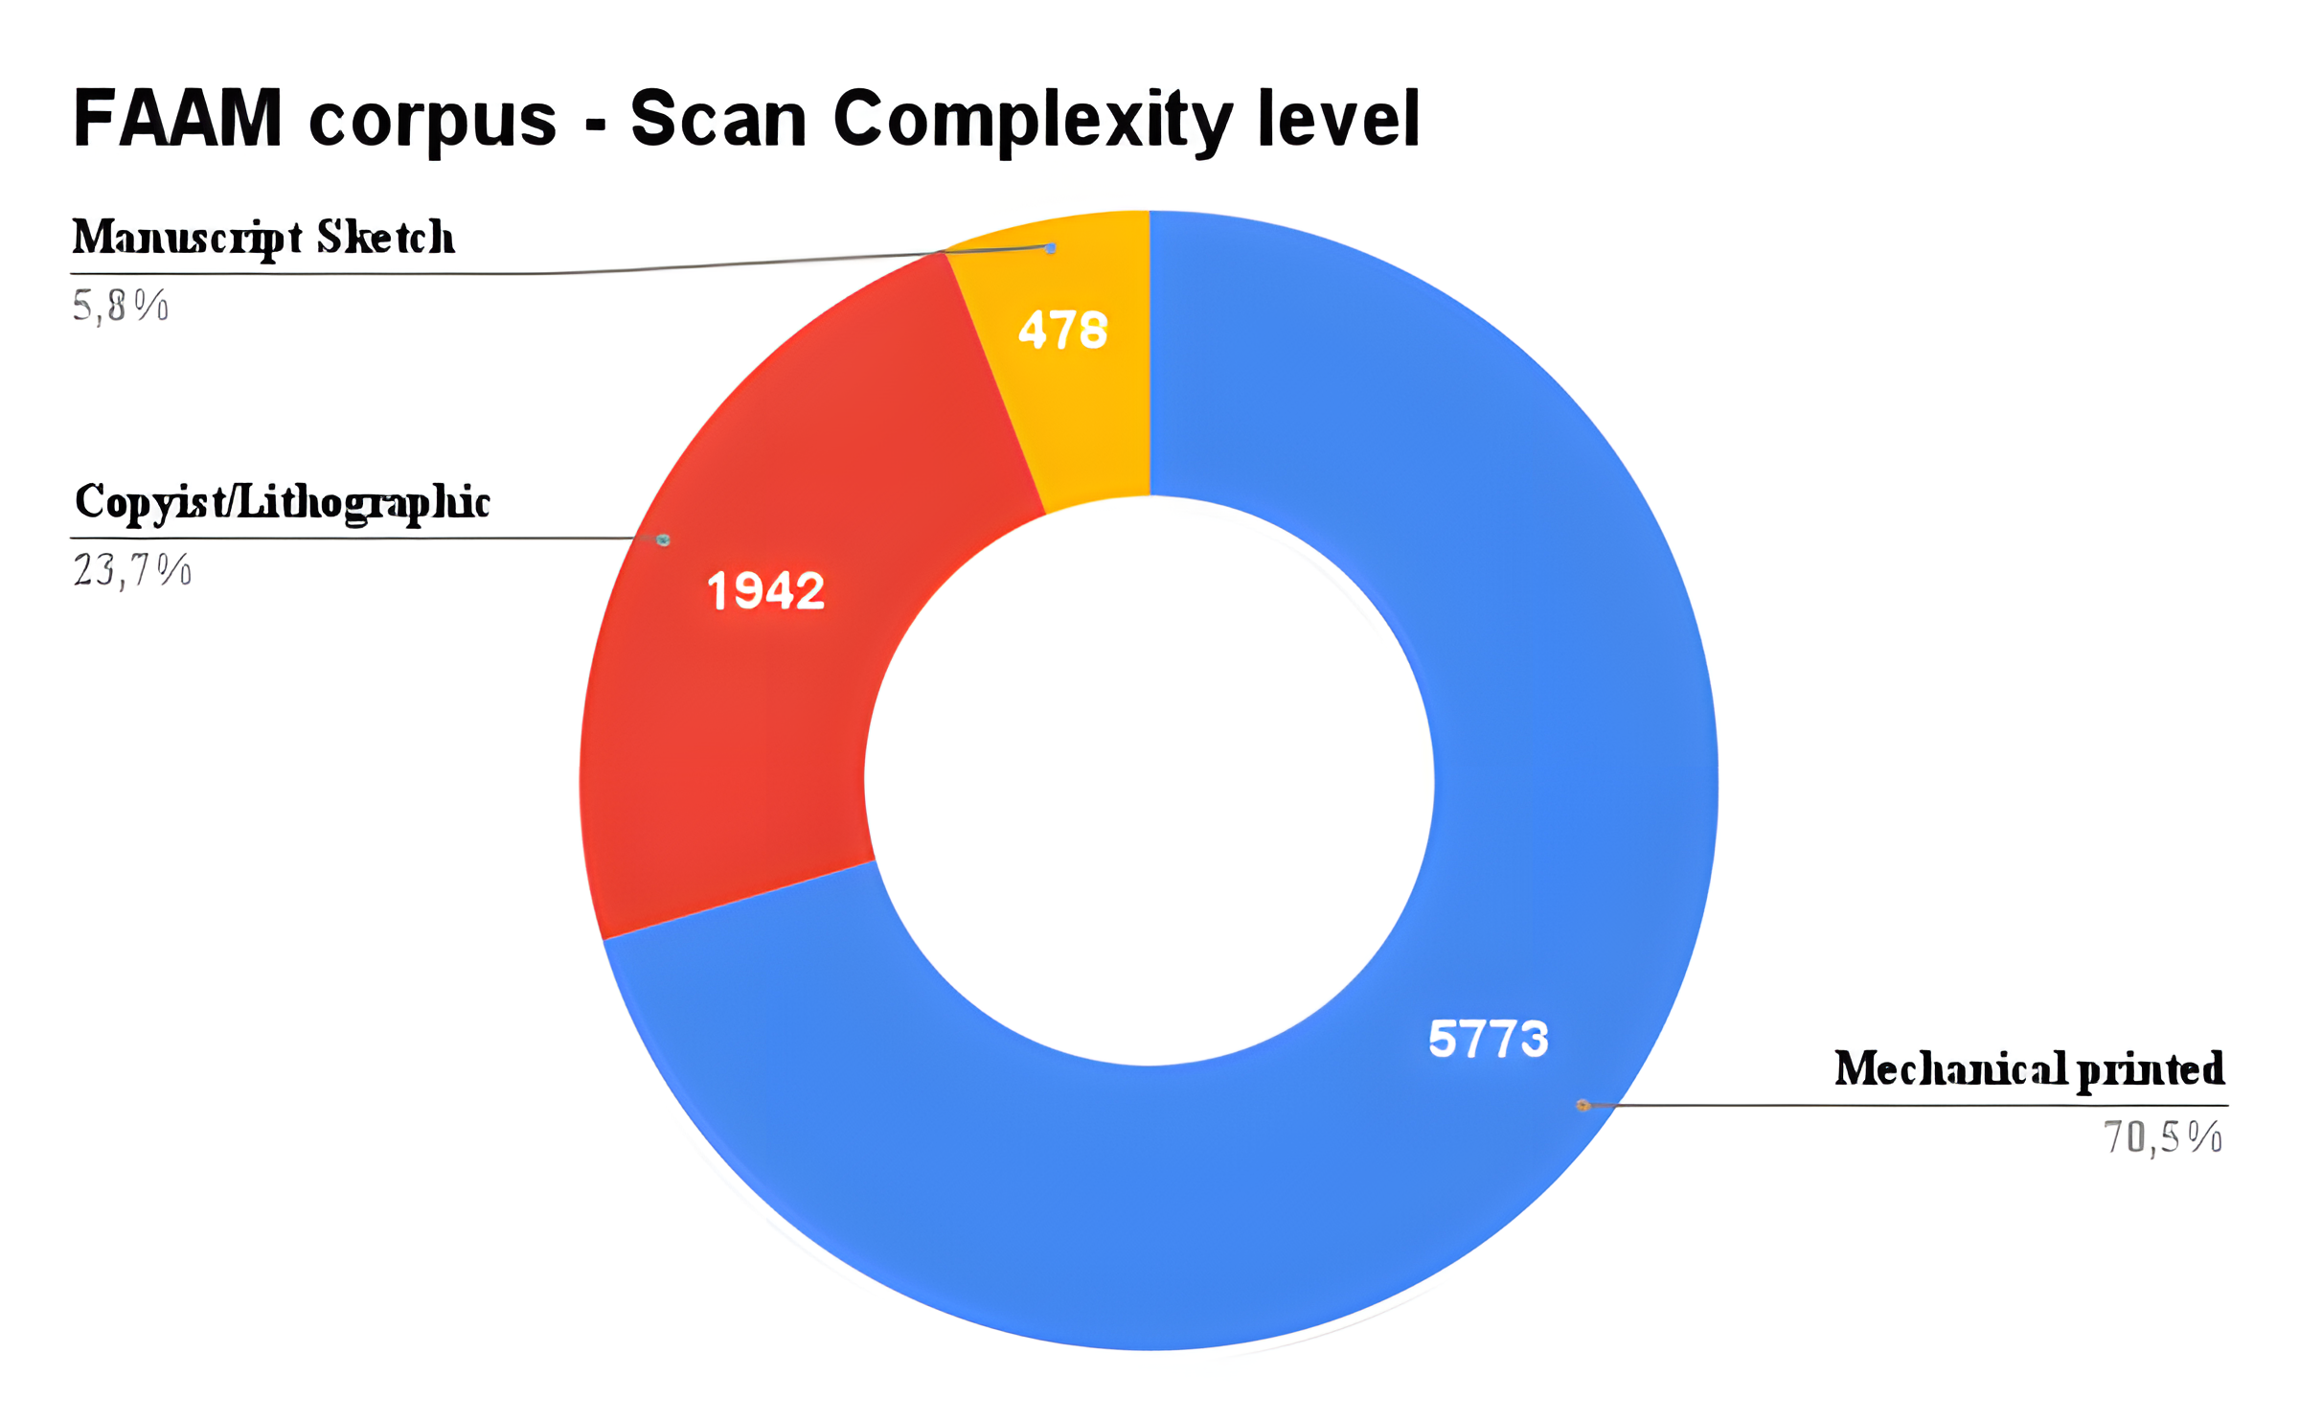
FAAM corpus – variety of data
Complexity level of scores, according to engraving format:
Manuscript Sketch
Copyist / Lithographic score
Mechanical printed score
Notes:
Total images 12.000
Records 328
We expect the numbers to grow exponentially!
KCA (Royal Conservatoire Antwerp)
KCG (Royal Conservatoire Ghent)
WML (J. William Marriott Digital Library - The University of Utah)
ZBZ (Zentralbibliothek Zurich)SZB (Staatsbibliothek zu Berlin)
BNF (Bibliothèque Nationale de France)
BSB (Bayerisch Stadsbibliotheek)
LH (Letterhuis Antwerp)
ULM (Universitäts- und Landesbibliothek Münster)
SSD (Sächische Staatskapelle Dresden)

Slide 13
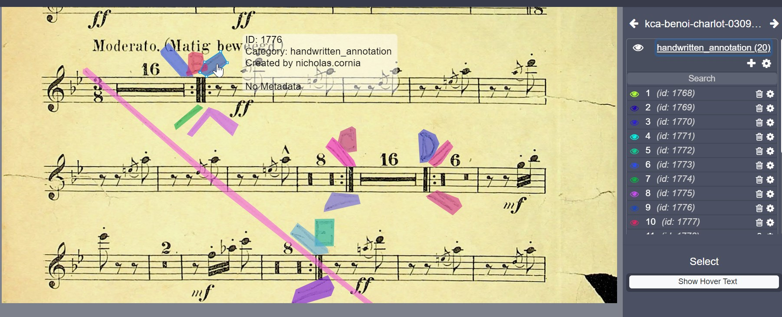
FAAM corpus – COCO annotations
Training dataset development
More than 4000 images of music scores
Over 300 pages as training set for handwritten annotation spotting
4342 individual polygonal bounding-boxes annotations
Notes:
Training set: 4226 images , 317 annotated -> handwritten annotation label
4342 polygonal bounding-boxes objects

Slide 14


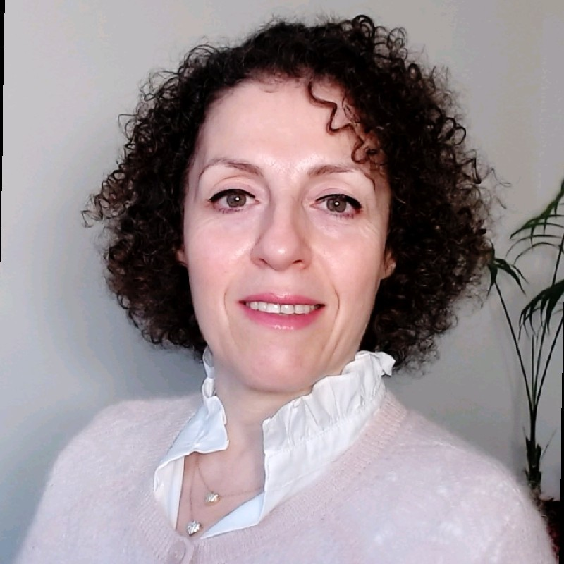
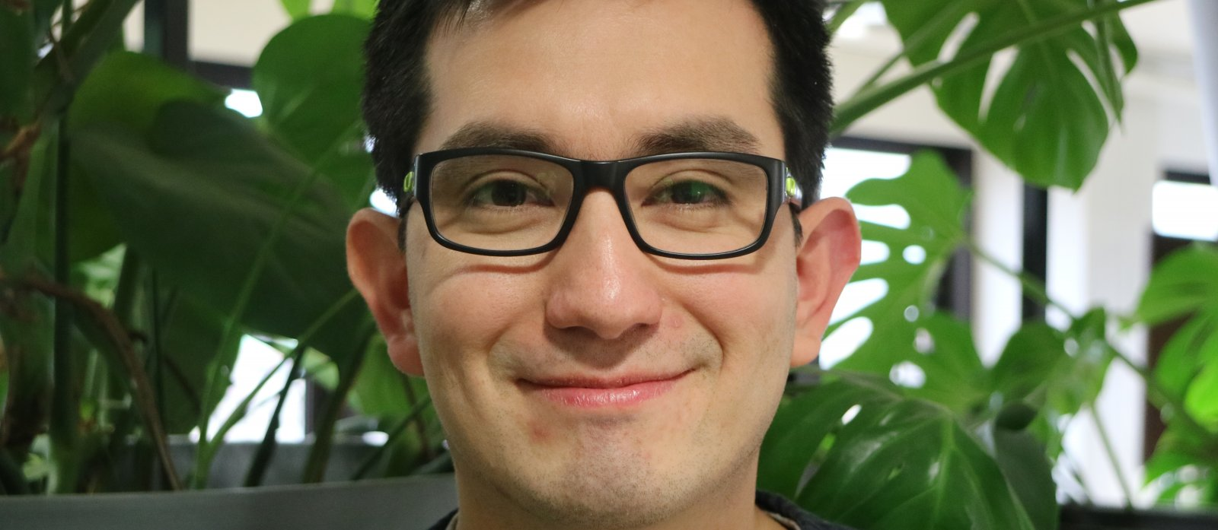
Project workflow – Short-term
Handwritten annotation spotting project, bachelor students of UAntwerp in collaboration with IDLab.
Case studies and recording sessions with professional musicians.
Workshops with Antwerp Conservatoire students
Notes:
Salma Haidar
José Oramas
Bachelor students:
Khalil Ouald Chaib
Ferit Murad

Slide 15

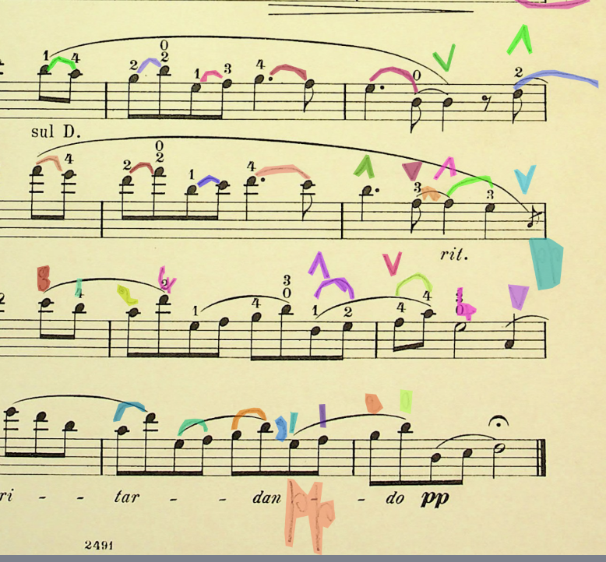
Imec – Bachelor project
COCO JSON-format
Binary classification: handwritten_annotation and background categories
Probability score for handwritten annotation spotting
Exploiting features of handwritten annotations:
Color separation
Comparison marked and unmarked scores
Spotting based on score lay-out regularity (printed scores)

Slide 16



Project workflow – Mid-term
Object recognition and Semantic reconstruction. OMR research with two master projects at UGent and UAntwerp.
MEI format (XML) integrating annotations, scores alignment and synchronization of recorded annotations.
Development of service for annotation spotting and metadata enrichment for digital libraries. The Historical American Sheet Music collection at Duke University.
Author recognition using Deep Learning.
Linked Open Data: ontology development, metadata enrichment of images (URI).
Notes:
CHASE project and other research based on annotation spotting. Synchronizing existing datasets with images.
Jan Aelterman and José Oramas. Wim Casteels

Slide 17
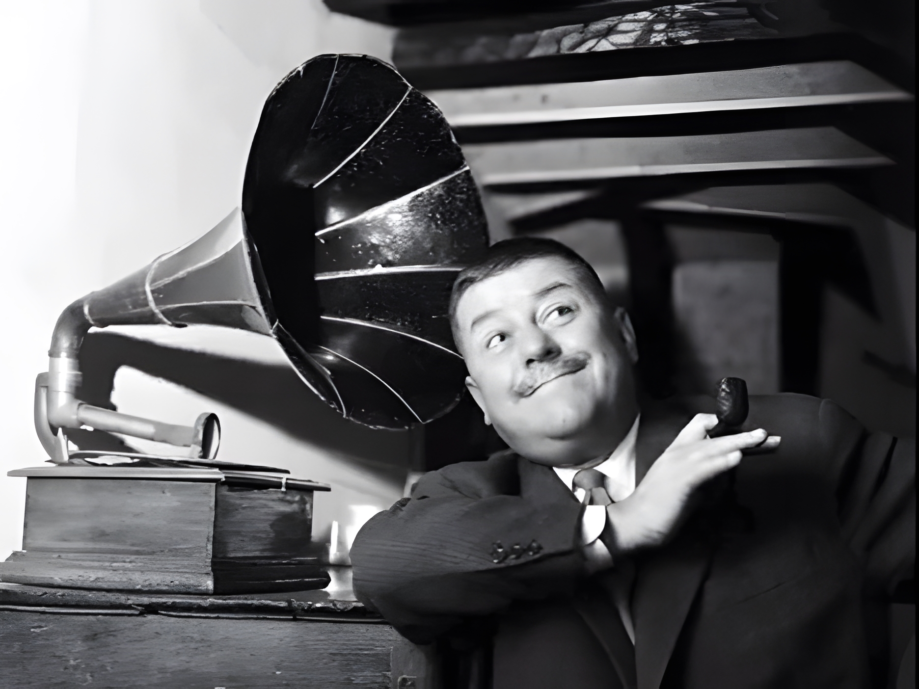

Conclusion
nicholas.cornia@ap.be
Notes:
Dankwoord – Lamyk, Sally, all the networking and colleagues
Vragen
Mogelijkheden voor samenwerking – CLARIAH, other libraries

